Slide 1

Renewables 2018
Analysis and Forecasts to 2023 – A focus on sustainable bioenergy
Mechthild Wörsdörfer, Director, Sustainability, Technology and Outlooks
COP24
Katowice, December 2018
IEA

Slide 2

Modern bioenergy: the overlooked giant of renewables
Total final energy consumption
from renewables, 2017
Total final energy consumption
from renewables by sector, 2017
6%
Modern
bioenergy
4%
Electricity
9%
Hydropower
Wind
50%
Solar PV
Heat
31%
Other
renewables
Transport
Electricity from
renewables
100
200
300
400
500
Mtoe
Modern bioenergy is the only renewable source that can provide electricity, direct heat and transport fuels Two thirds of modern bioenergy heat is used in industry

Slide 3
Modern bioenergy set to lead renewables growth
Total energy consumption growth of renewables over 2012-23
Transport
Electricity
Buildings Industry
Total renewable energy consumption is expected to increase by almost 30% over 2018-2023,
covering 40% of global energy demand growth

Slide 4
Brazil has the highest share of renewable energy
Renewables contribution to energy consumption by country in 2017 and 2023
China accounts for the largest absolute growth over the forecast period surpassing the EU,
while renewable energy consumption in India increases by 50%

Slide 5
Asia and Latin America dominate biofuel production growth
Biofuel production growth 2018-23
Renewables consumption in transport in 2023
Road biofuels
Aviation biofuels
Maritime biofuels
Rail electricity
Road electricity
Other electricity
Biofuels production grows by 16% led by Brazil; EVs electricity consumption triples, with renewables providing 30% of demand from electrified transport by 2023

Slide 6
Bioenergy to continue dominating renewable heat consumption
Renewable heat consumption by source in buildings and industry
Bioenergy is particularly prevalent in industry, whereas in buildings growth in solar heat and renewable electricity is pushing bioenergy from the top spot.

Slide 7
Renewables share of energy consumption increases by one-fifth
Share of renewables in the electricity, heat and transport sectors
Electricity contributes to two-thirds of renewables growth but heat remains the largest end-use by 2023
Overall, renewables are not on track to meet long-term climate goals

Slide 8
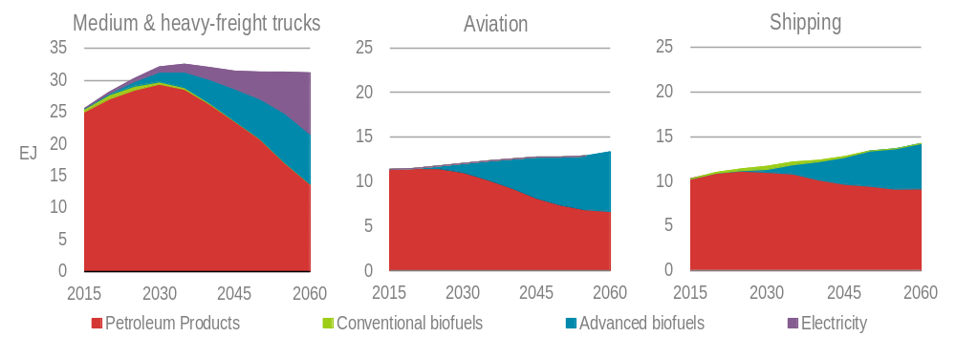
Advanced biofuels needed to decarbonise transport in the long-term
Final energy consumption by fuel in long-haul transport modes in the 2DS (2015-60)
Innovation in advanced bioenergy technologies is needed to utilize the vast untapped and sustainable resource potential from waste and non-food feedstocks

Slide 9
Conclusions
Modern bioenergy will continue to lead renewables growth in the next five years and its untapped potential remains huge particularly in China, India, Brazil and the EU
Further accelerating the use of modern bioenergy hinges on policies & incentives to foster innovation and on rigorous sustainability frameworks
Innovation is needed to accelerate advanced biofuels production from vast untapped and sustainable feedstocks
Greater use of solar, wind, bioenergy & other renewables – together with energy efficiency & other clean energy technologies – is needed in all sectors for emissions to peak rapidly then decline
    Electrification of end-use sectors
    Better alignment of energy efficiency and renewable energy policies
    Enhanced direct renewable heat uses
    Stronger renewables penetration in industry, including through hydrogen-based fuels & feedstocks

