Slide 1
Tracking energy efficiency indicators
in households
Thomas ELGHOZI | International Energy Agency
Joint APEC-IEA training workshop on end-use energy consumption data – Nov. 16th 2022

Slide 2

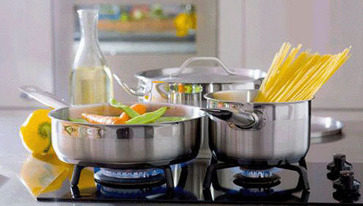
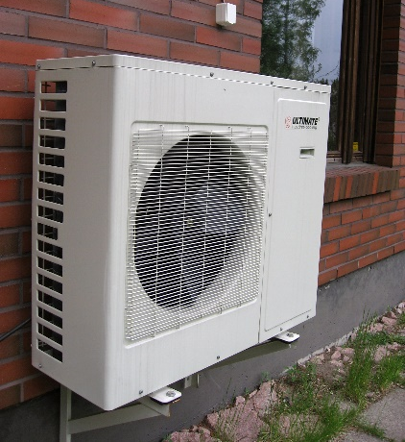
Why is the residential sector important?
Residential buildings and appliances determine our quality of life!

Slide 3
Overview
What we can learn from the energy balances?
What can we learn from end-use data and energy efficiency indicators?
  Examples from similar economies
  Collecting end use data and developing indicators
How to collect data on residential buildings?
  Data collection: a dialogue with other economies
Appendix: how to perform temperature correction?

Slide 4
What can we learn from
the energy balances?

Slide 5
Residential consumes a fifth of final energy in APEC and IEA
Total final energy consumption¹ in APEC and IEA in 2019
¹ Total final energy consumption excluding non-energy use
² Other includes agriculture, forestry, fishing and non-specified final consumption
Source: IEA Energy Balances, 2021
The residential sector accounts for about 20% of the final energy consumption, both in the APEC
and IEA economies. It’s the third largest sector, after industry and transport.

Slide 6
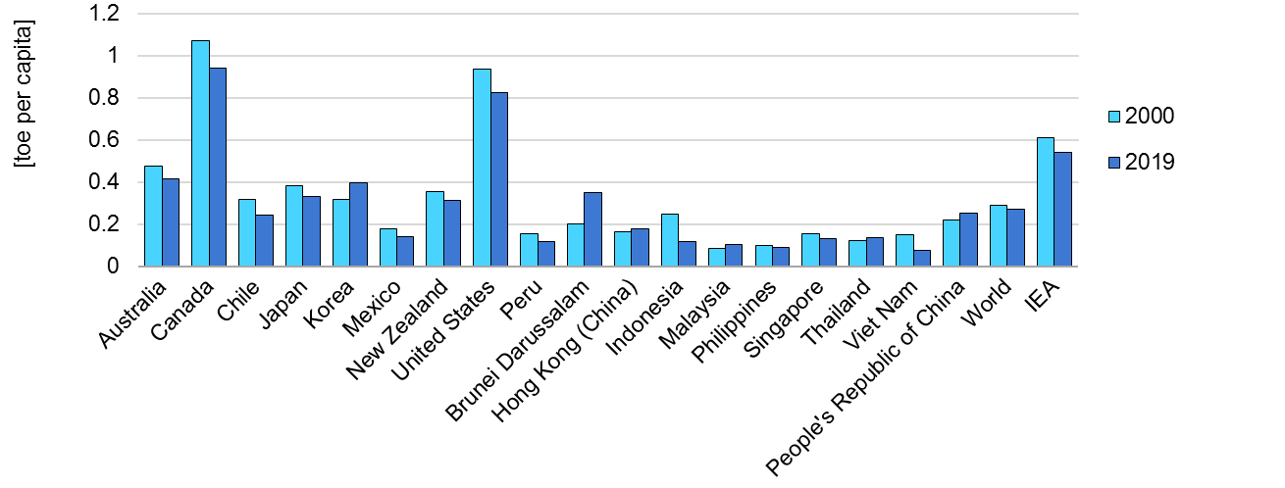
Residential energy consumption varies between economies
Energy consumption in residential per capita
Source: IEA Energy Balances, 2021
Residential consumption is very dependent on the climate and the quality of life (size of dwellings, appliances…),
so it varies greatly between economies. Per capita consumption decreased in most places.

Slide 7
Fuel share in residential sector
Energy consumption in residential sector in Japan and Chile in 2019
Source: IEA Energy Balances, 2021
Fuel share may vary depending on heating and cooling systems,
main fuel for cooking, and use of residential appliances.

Slide 8
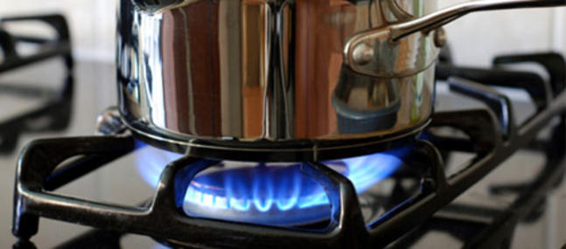

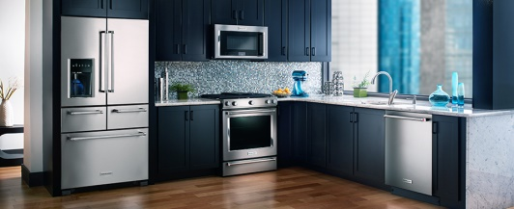
What else do we need to know to track efficiency in residential?
Which end uses consume the most energy (heating, cooking, cooling…)?
Which aspect of our life will be affected in case of energy price spike?
What is the share of LPG / electricity used for cooking?
Are we using energy for space heating more efficiently over time?

Slide 9
What can we learn from end-use data and
energy efficiency indicators?

Slide 10
Examples from similar economies

Slide 11
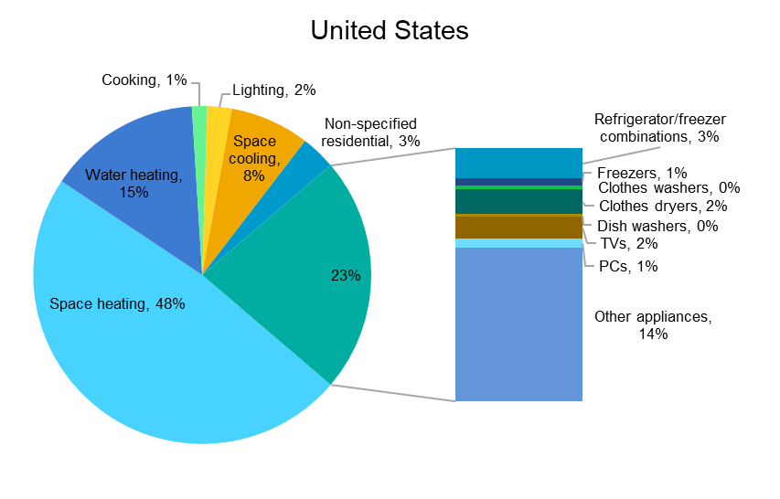
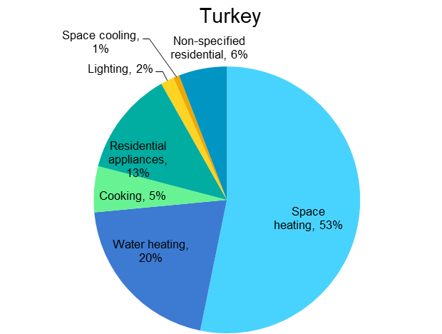


Detailed end-use data provides more information for policy focus
Residential energy consumption by end use in Turkey and the United States, 2019
Residential appliances,
Source: IEA Energy Efficiency Indicators, 2021
Detailed consumption by end use allows to analyse energy consumption.
Turkey and the United States show consumption similarities despite being very different countries.

Slide 12

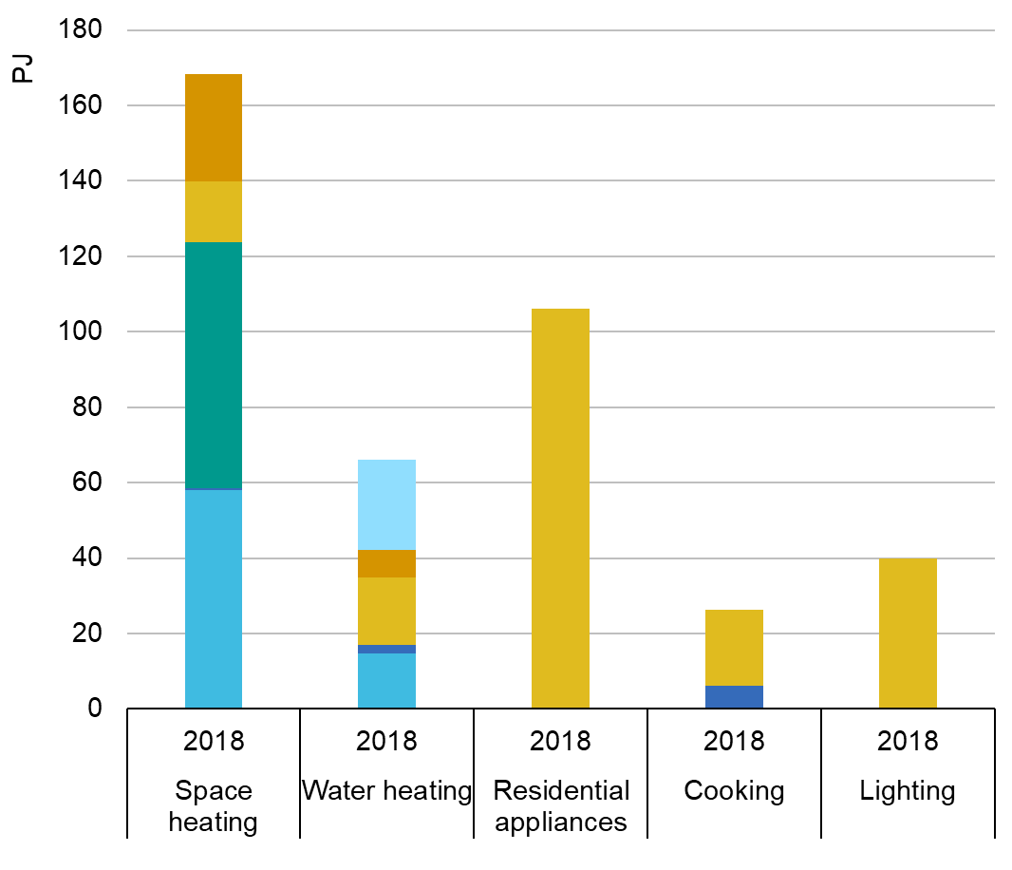
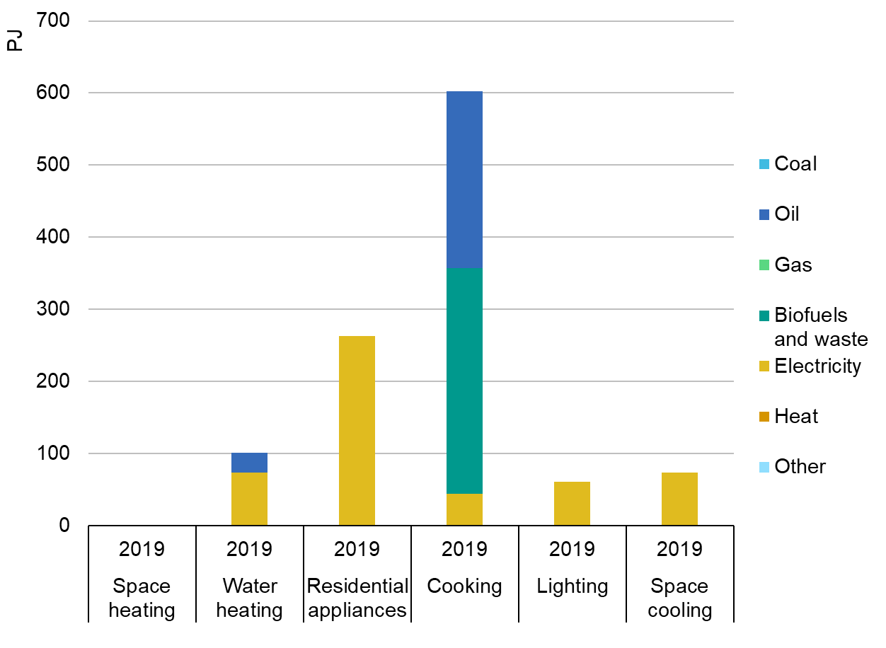
Fuel share by end use gives crucial insights on the energy system
Residential energy consumption by fuel and end use, in Turkey (left, 2018) and Brazil (right, 2019)
Source: IEA Energy Efficiency Indicators, 2021
Consumption data split by end use and by fuel allows to understand the impact of weather,
technology deployment and cultural habits on the energy system.

Slide 13
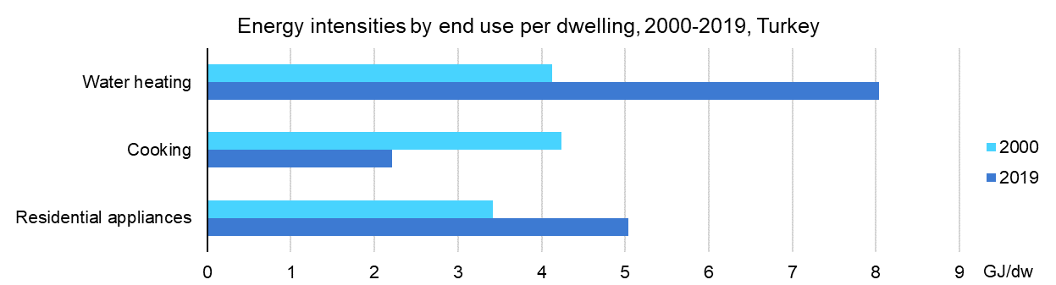
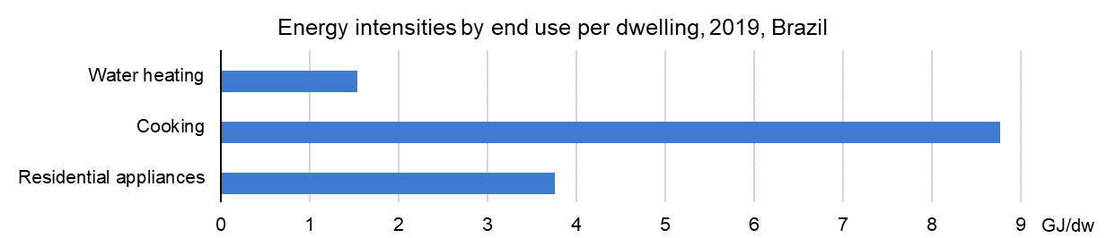
Efficiency indicators to compare periods and regions
Source: IEA Energy Efficiency Indicators, 2021
Residential consumption by end use and activity data allow to identify the most intensive end uses,
follow the evolution through time and compare regions.

Slide 14
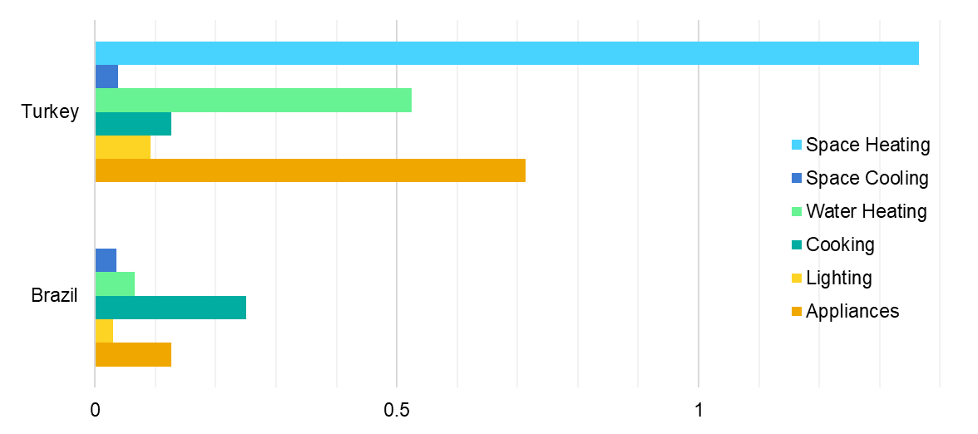
Breaking into different carbon intensities for each end use
Residential carbon intensity of various end uses, in Turkey (left) and Brazil (right) in 2019
Source: IEA Energy Efficiency Indicators, 2021
tCO₂/dw
End use and fuel shares of residential consumption allow to identify the most intensive end uses.
It also clarifies why, from the fuels on which they rely, providing key information to tailor energy policies.

Slide 15
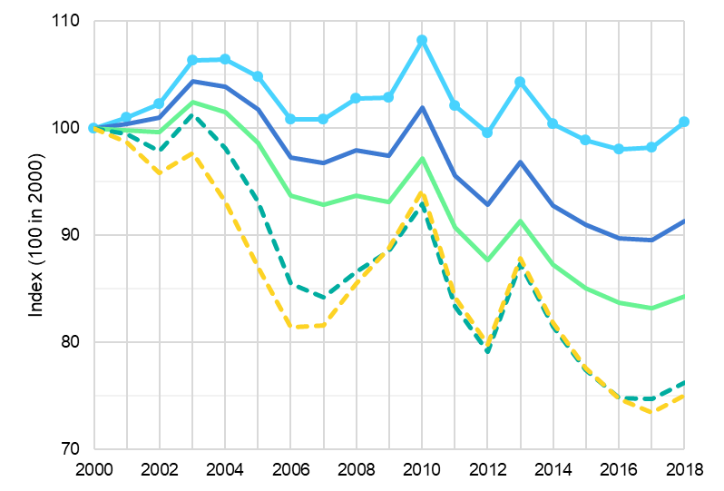
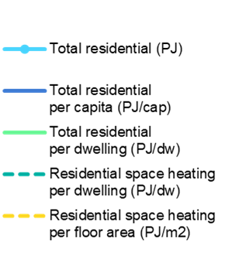
Efficiency indicators to explain consumption patterns and trends
Residential energy consumption in IEA, 2000-2018
+1%
-25%
Source: IEA Energy Efficiency Indicators, 2020
Efficiency indicators help understand the trends and key drivers of energy consumption,
here thanks to residential activity data: population, number of dwellings and size of dwellings.

Slide 16
Collecting end use data and
developing energy efficiency indicators

Slide 17
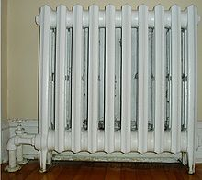
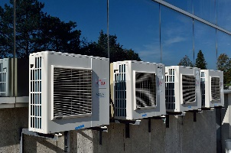
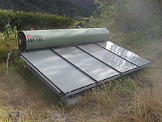
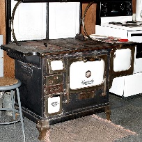
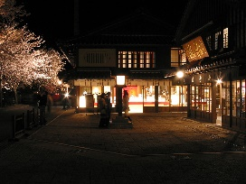
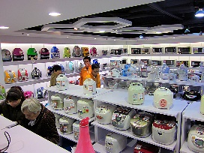
Residential indicators – Energy and activity data
Energy consumption data
Space heating*
Space cooling*
Water heating
Cooking
Lighting
Appliances energy consumption (refrigerator, freezer, cloth washer, cloth dryer, dish washer, TV, computer)
Space heating
Space cooling
Water heating
Cooking
Lighting
Appliances
*: Temperature corrected, using HDD and CDD
Activity data
Population
Number of occupied dwellings
Residential floor area
Appliances stock and diffusion
Activity data
Population
Number of occupied dwellings
Residential floor area
Appliances stock and diffusion

Slide 18

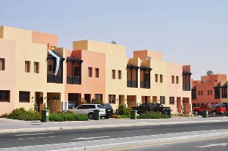

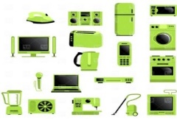
Residential indicators – Energy and activity data
Energy consumption data
Space heating*
Space cooling*
Water heating
Cooking
Lighting
Appliances energy consumption (refrigerator, freezer, cloth washer, cloth dryer, dish washer, TV, computer)
Occupied dwellings
Population
*: Temperature corrected, using HDD and CDD
Activity data
Population
Number of occupied dwellings
Residential floor area
Appliances stock and diffusion
Residential floor area
Appliances stock
and diffusion
Icon credits: agus raharjo (creative commons)

Slide 19

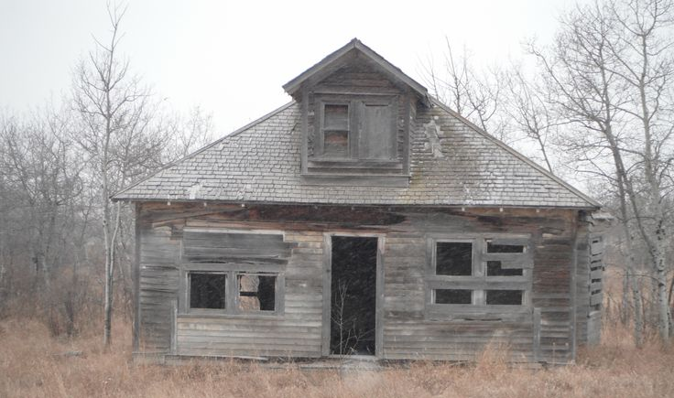

Occupied dwellings vs total dwellings
Primary residences
Unoccupied dwellings
Vacation homes

Slide 20

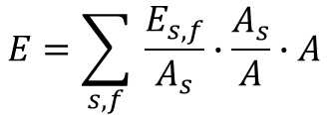
What drives the residential energy consumption?
Drivers of residential energy consumption, New Zealand, 2000-2020
Kaya-like equation
Energy consumption
Energy efficiency
(energy / activity)
$$E=\sum_{s,f}{ \frac{E_{s,f}}{A_{s}}∙\frac{A_{s}}{A}∙A}$$
Total activity
Economic structure
(sectoral activity / total activity)
for each end use $s$ and for each fuel $f$
Source: IEA Energy Efficiency Indicators, 2021
Decomposition analysis from detailed end use and activity data gives the respective impact of key drivers of residential energy consumption, and providing key insights for policy design.

Slide 21
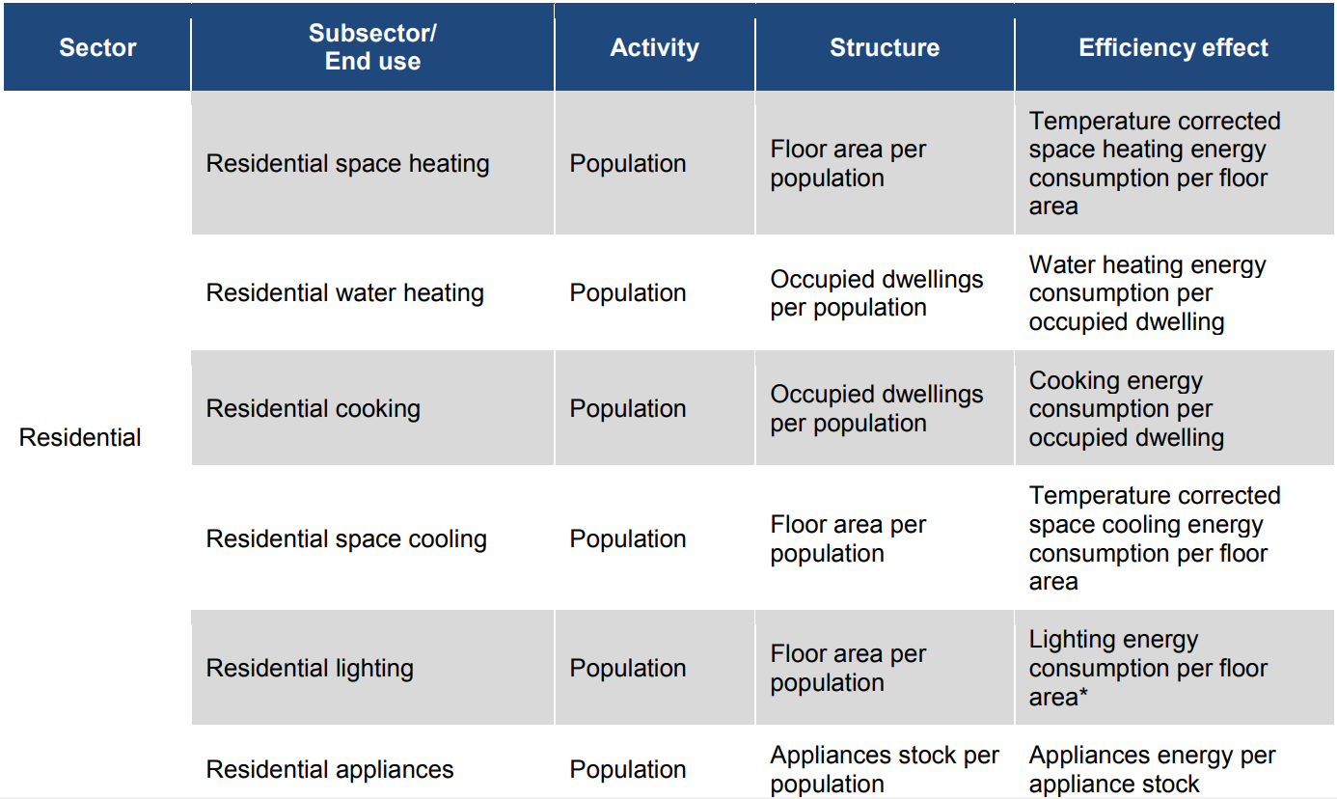
Decomposition analysis for the residential sector
Factors of activity, structure and efficiency effects for each residential end use in our decomposition analysis
Source: IEA Energy Efficiency Indicators, 2021
Activity is tracked though population, number of dwellings, residential floor area, and appliances stock.
Various indicators can be build, but one needs to choose carefully the most relevant.

Slide 22
How to collect data on residential buildings?

Slide 23


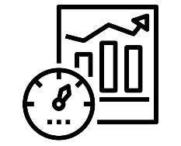

Methods to collect residential end-use and activity data
National statistics office
Land registry
Building registers
Administrative
sources
Basis as many data are often already gathered. Essential starting point.
Costly but very effective. To be designed carefully, ideally from existing one. Representative sample is key.
Costly but very effective. Often focused on specific equipment.
Complementary to survey (e.g. for higher frequency) or stand-alone. Requires robust input data.
Real estate
Manufacturers / vendors
Building managers or residents
Survey
Utilities
Fuel vendors
Smart meters
Measuring
Sales, stocks and replacement rates of heating / cooling systems and appliances
New dwellings
Modelling
Always check what data may be available in other institutions and
how to complete existing data collection, before setting a new one up.
Icon credits: Iconiqu; Nithinan Tatah

Slide 24
Data collection: a dialogue with other economies
What worked well? What to avoid?

Slide 25

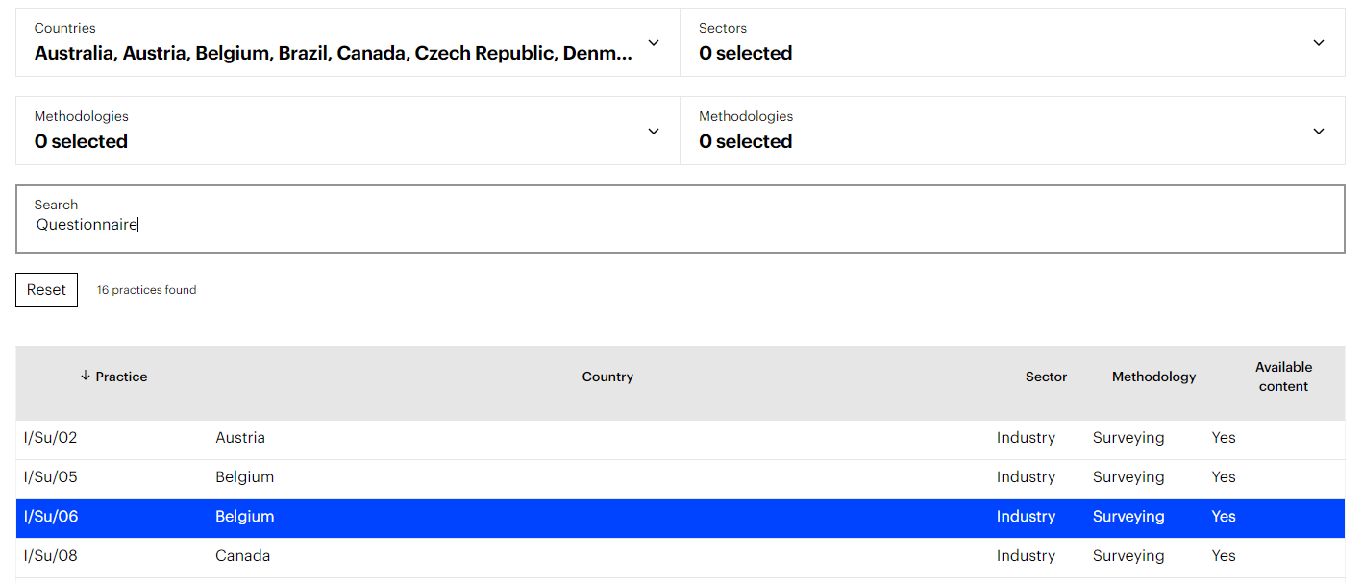
IEA sharing platform – An experience database
  Contact us at EnergyIndicators@iea.org and share your practice
https://www.iea.org/articles/national-data-collection-practices
A searchable database, gathering data collection practices from a variety of economies, to share expertise worldwide

Slide 26
Successful data collections – Tools
Indonesia
USA
Australia
New Zealand
Philippines
USA
Digitalise data storage to efficiently share data
Consider merging with other surveys, harmonising data collections
Consolidate estimates used as input data through feedback
Ensure robust quality controls, from input data to modelling assumptions
Carefully design questionnaire, focusing on user-friendliness, interview time and multiple languages
Carefully design surveying tool, including error and check management, and accuracy of qualitative questions
Administrative
sources
Modelling
Survey
Carefully designed tools, based on needs and available resources, are essential for efficient data collections.
Icon credits: Iconiqu; Nithinan Tatah

Slide 27
Successful data collections – Resources and methodology
Administrative
sources
Canada
New Zealand
Indonesia
Mexico
Hong Kong
Thailand
Need clear, reliable institutional arrangements
Allow resources and documenting over the whole deployment time
Carefully record model documentation
Define clear assumptions, in line with available input data
Ensure quality and resilience of the interviewing staff
Provide enough staff and resources for data processing
Measuring
Modelling
Survey
Durable resources – in staff, finances and framework – need to be allocated to ensure robust data collections.
Icon credits: Iconiqu; Nithinan Tatah

Slide 28
Successful data collections – Human factors
Administrative
sources
USA
New Zealand
China
Indonesia
Philippines
Ensure long-term access to the right respondents
Ensure longevity of measurement agreements thanks to long-term relationships
Provide non-monetary incentives and modelling complement
Establish local community relationships to obtain support and increase response rate
Reinforce institutional arrangements to ensure survey frequency
Measuring
Survey
Foster relationships with every partner – institutions, companies, communities – is key for high quality data.
Icon credits: Iconiqu; Nithinan Tatah

Slide 30
APPENDIX
How to perform temperature correction?

Slide 31
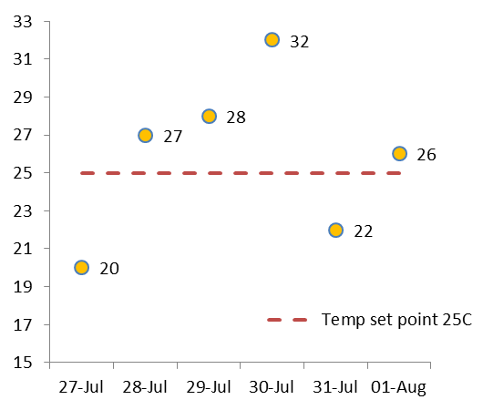
Temperature correction – Cooling degree days
Daily temperatures (°C)
Method for CDD
Set a temperature threshold
Method for CDD
Set a temperature threshold
For each day, compute the positive difference to the threshold
Sum up over the period
Method for CDD
Set a temperature threshold
For each day, compute the positive difference to the threshold
CDD_{(27Jul-01Aug)} = 0 + 2 + 3 + 7 + 0 + 1 = 13
With warmer weather, we consume more for space cooling in buildings.

Slide 32
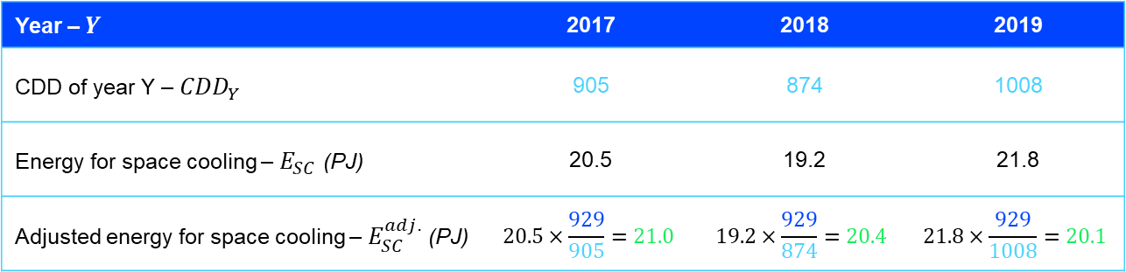

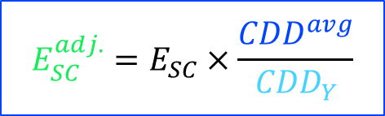
Temperature correction – Adjusting energy consumption
$$E_{SC}^{adj.}=E_{SC}×\frac{{CDD}^{avg}}{{CDD}_{Y}}$$
Adjusted energy for space cooling (simplified method)
Average CDD
Adjusted energy consumption
Actual energy consumption
CDD of current year
Calculation example
Average CDD over the period ${CDD}^{avg}=929$
Year – $Y$ | 2017 | 2018 | 2019
CDD of year Y – ${CDD}_{Y}$ | 905 | 874 | 1008
Energy for space cooling – $E_{SC}$ (PJ) | 20.5 | 19.2 | 21.8
Adjusted energy for space cooling – $E_{SC}^{adj.}$ (PJ) | $$20.5×\frac{929}{905}=21.0$$ | $$19.2×\frac{929}{874}=20.4$$ | $$21.8×\frac{929}{1008}=20.1$$

Slide 33
Temperature correction – Adjusted energy consumption
Temperature correction allows to identify more clearly the trends, removing the weather impact on consumption.

