Slide 1
Energy efficiency in a time of Covid-19
A vehicle for economic and social relief & recovery in Latin America

Slide 2
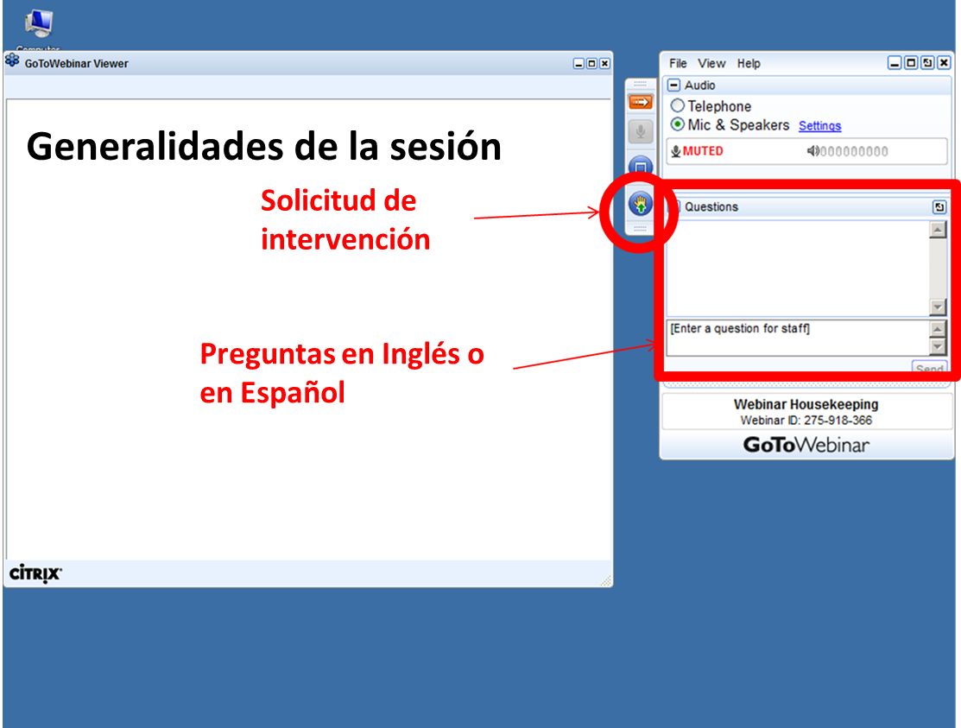

Welcome to the webinar platform
Attendee Interface
Question box
Questions in English, Spanish or Portuguese
Access Code: 919-820-423
Audio PIN: Shown after joining the webinar
Notes:
Call in if audio issues
Being recorded
Questions

Slide 3



Introducing today’s presenters
Edith Bayer
Michael Oppermann
Ghislaine Kieffer

Slide 4
Introduction

Slide 5
Today’s presentation: why energy efficiency?
Shovel-ready, local, sustainable jobs
Resilience (of energy system, of building stock, of economies)
Decent housing, affordable cooling, lower bills
Improves air quality
Key to meeting climate change objectives and sustainable development goals
Notes:
Many benefits in addition to E savings. Today, it is more important than ever to recognize the value of EE. The IEA has for years been collecting data and analysing progress with EE p & ps. In the context of Covid-19 we’ve redoubled our efforts to assess how EE fits into the context of Covid relief and recovery.

Slide 6
Where were we before Covid-19?

Slide 7
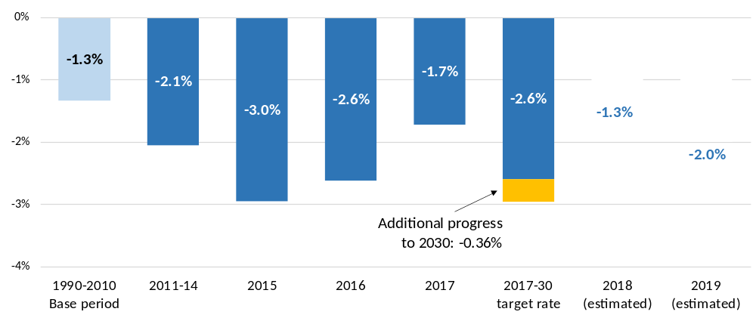
Global energy efficiency improvements were slowing down
Growth rate of primary energy intensity, by period and target rate, 1990-2030
To meet the Sustainable Development Goals’ target 7.3 - to improve intensity by 2.6% per annum - the world now needs to improve by 3% per annum to 2030 to realise the efficiency goal.
https://www.irena.org/publications/2020/May/Tracking-SDG7-The-Energy-Progress-Report-2020
Notes:
Primary energy intensity refers to the amount of energy used per unit of global GDP, it is the global proxy that is used to track rates of energy efficiency improvement.
As we can see here, between 1990 and 2010, global primary energy intensity fell by an average annual rate of 1.3%, this rate of improvement formed the basis for SDG target 7.3, which aims for an average annual rate of improvement in global primary energy intensity of 2.6% between 2010 and 2030.
The first part of this decade has seen a gradual rise in rates of improvement, with global primary energy intensity improving by 3% in 2015. Since then, improvement rates have declined, reaching 1.7% in 2017.
Despite the positive step-up this decade, rates of improvement in global primary energy intensity are still behind the SDG target 7.3. As a result, the annual rate of improvement between 2017 and 2030 now needs to average 3%, to compensate for this shortfall.
Unfortunately, initial estimates for 2018 and 2019 indicate that the rates of primary energy intensity improvement are still below the required rate, and means the average improvement rate from today will have to be above 3% per year to realise the energy efficiency target.
This slowdown would place further pressure on meeting SDG target 7.3, meaning that if the goal is to be achieved, the world must step-up its action on energy efficiency. Fortunately, as highlighted in IEA reports, including the Energy Efficiency 2018 and WEO 2019 reports, there is still considerable cost-effective potential to improve energy efficiency. Government policy is the key to realising this potential, with key actions including increasing the coverage and strength of mandatory energy efficiency codes and standards, providing incentives and finance to push markets towards best available technology, and providing information and capacity building resources to improve skills and understanding relating to energy efficiency.
In the wake of the Covid-19 pandemic initial indications for intensity improvements in 2020 are uncertain, as both energy consumption and GDP are likely to be significantly lower. Importantly, there is likely to be a substantial fall in energy efficiency investment. The recent IEA World Energy Investment 2020 report suggests this fall in efficiency investment could be as large as 10% this year. Governments around the work are spending trillions of dollars on recovery packages, and there are opportunities to use this funding to support energy efficiency whilst investing jobs and the economy. [add anything specific on upcoming WEO SR report]
[regional message. These figures mask what is happening regionally and by end-use. For example, energy consumption in the United States and Europe has remained flat since 2010, whilst GDP has increased at 2% per annum]

Slide 8
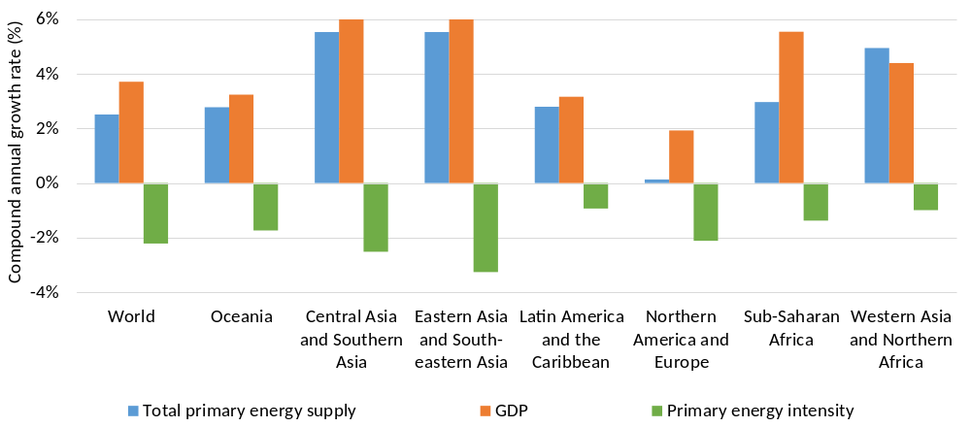
The rate of improvement varied across regions
Growth rate of GDP, primary energy demand, and regional energy intensity, 2010–17
Largest improvements are seen in Asia, whilst Latin America and the Caribbean the least improvements. Energy consumption in America and Europe has plateaued, despite GDP grow at 2%
https://www.irena.org/publications/2020/May/Tracking-SDG7-The-Energy-Progress-Report-2020
Notes:
When we look at primary energy intensity at a regional level, we get a greater insight into what is driving global trends.
Sub-Saharan Africa is the most energy-intensive region; Latin America and the Caribbean the least.
However, between 2010 and 2017, energy-intensity improvements continued to be highest in Asia; most countries in the region saw rates of improvement in energy intensity that were higher than during 1990–2010 and well above the global average (e.g., 3.3 percent in Eastern Asia and South-eastern Asia). The lowest rates of improvement were found in Latin America and the Caribbean (0.5%), Northern Africa (0.4 percent) and the Middle East (0.3 percent).
Between 2010 and 2017, primary energy intensity in Eastern and South eastern Asia improved by an annual average rate of 3.4% and in Central and Southern Asia, the rate was 2.5%. These rates are well above the global average of 2.3% and a significant step up from historic trends.
China has been the driving force behind these trends in Asia. As a result of its massive economic expansion, China has overtaken the United States as the country with the largest total primary energy demand in the world. However, this increase would have been even greater were it not for the concerted policy efforts from the Chinese government to improve energy efficiency.
Starting with its 11th five year plan, China has implemented sweeping energy efficiency policies, including mandatory energy efficiency improvement targets on its largest industrial energy users and car and truck fuel efficiency standards.
This policy action saw primary energy intensity in China improve by an average annual rate of 4.7% between 2010 and 2016, the highest observed across the 20 countries with the largest primary energy demand in the world.
Progress in India is the driving force behind trends in Central and Southern Asia. Similar to China, India has also stepped up its action on energy efficiency, to reduce the impact on energy use from the modernisation of its economy. Policy is again the critical factor with implementation of standards and industrial policies mandating efficiency improvement. Creative financing schemes are also driving the deployment of energy efficient appliances, particularly LED lighting, which is improving access and energy efficiency.
In advanced economies, particularly those in Northern America and Europe, rates of progress between 2010 and 2016 were just below the global average. Many of these countries have had an extended history of energy efficiency policy, with the benefits continuing to flow to energy users. An important challenge for these countries will be to maintain and strengthen existing energy efficiency policies, so as to grow their impact and provide an example for other countries.
In Latin America and Africa, rates of energy intensity improvement are still lagging behind the global average. It should be noted that absolute levels of energy intensity in these regions are less than the global average, reflecting differences in economic structure, energy supply, and access. As economies in these regions modernise, governments will be able to take lessons from China and India, who have embraced strong action on energy efficiency to limit the impact of economic growth and improve access to modern energy services.

Slide 9
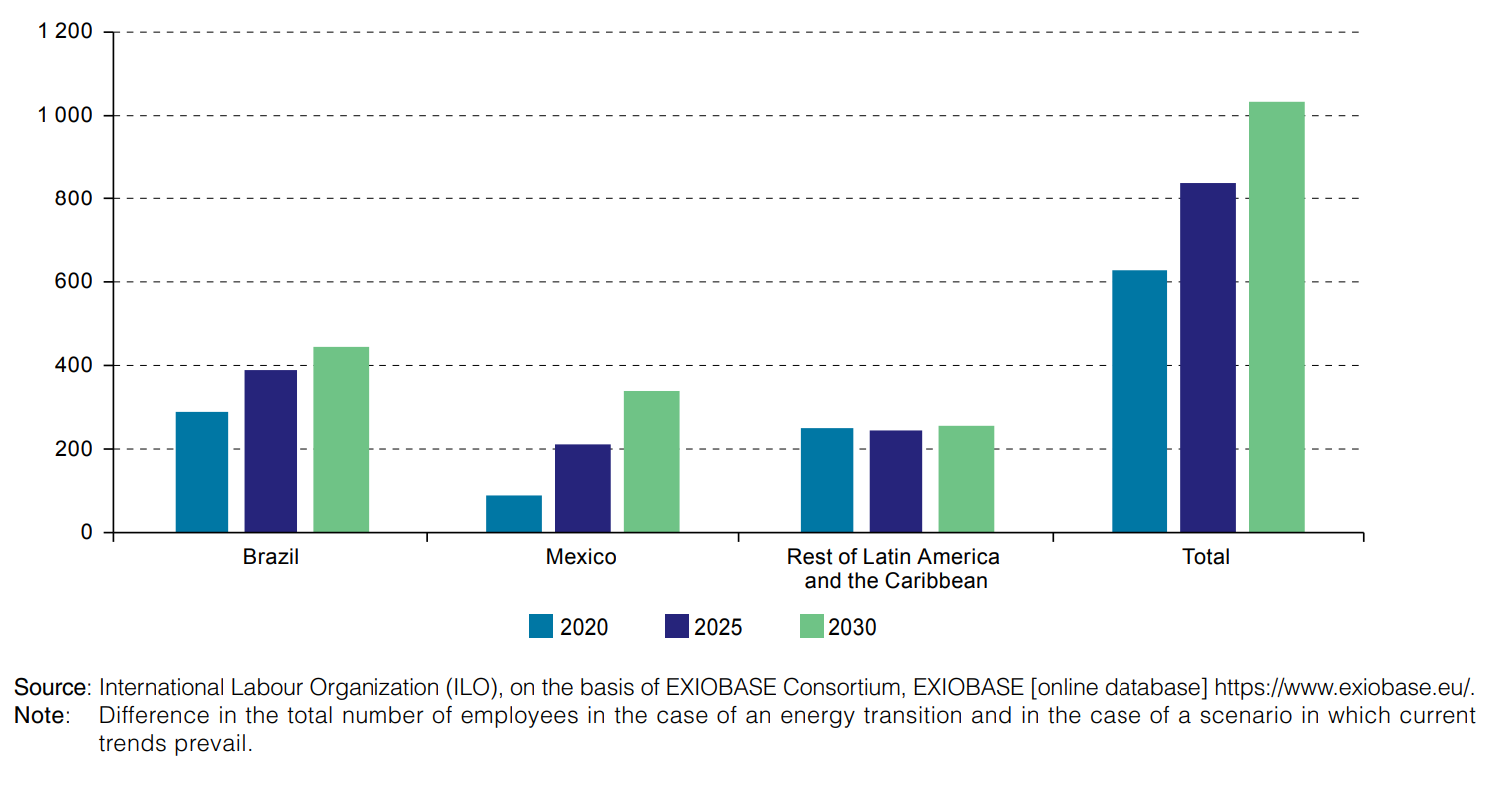
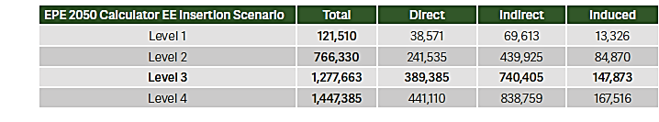
Potential for job creation
Net job creation against the backdrop of an energy transition, 2020-2030
Thousands of jobs created
https://repositorio.cepal.org/bitstream/handle/11362/44186/1/S1800885_en.pdf
Projection of FTE jobs in 2030 due to activity in EE sector in Brazil
https://iei-brasil.org/2019/05/01/potencial-empregos-eficiencia-energetica/
Notes:
More than 1 million jobs by 2030 – and greater EE would create more than 750,000 additional jobs in the construction sector.
Brazil – projections aligned with NDCs (Level 3) show more than 1 million jobs just in Brazil from EE.
The table depicts the projections of direct, indirect, induced, and total FTE (Full-time Equivalent) jobs in 2030 in the entire economy due to the production of goods and services in the EE sector, for each of the four EE scenarios presented by EPE (Energy Research Office – Brazil)
EPE’s 2050 Calculator sets forth four EE insertion scenarios, estimating the level of energy saved in 2050 for each, where Level 1 represents a very pessimistic scenario; Level 2, a slightly better possibility; Level 3 is in line with the Brazilian NDC’s; and Level 4 is the most optimistic scenario, maximizing industrial EE. Using the calculator’s Level 3 scenario, which is in line with the Brazilian NDC’s, a factor of 0.62 TWh per billion BRL was established as the relationship between energy saved and economic
activity of the EE sector

Slide 10
Impact of Covid-19

Slide 11
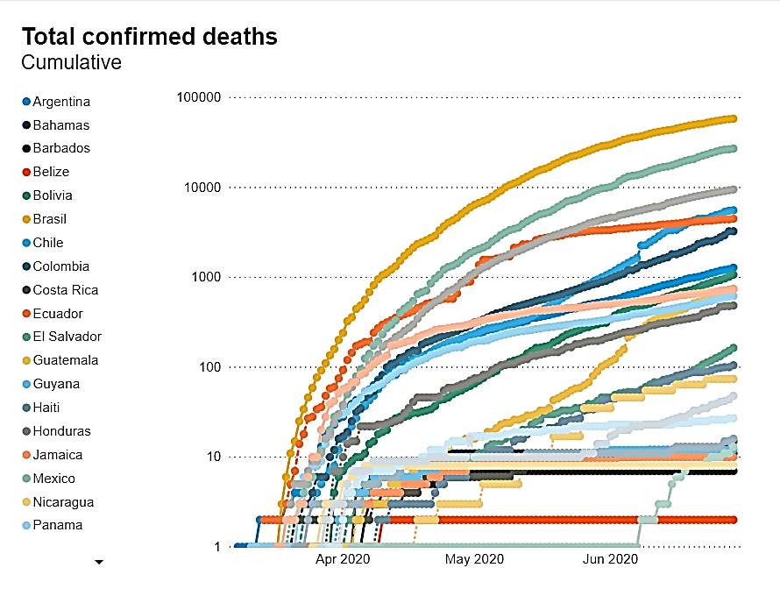
Immense toll of Covid-19; cases still rising in many places
https://www.iadb.org/en/topics-effectiveness-improving-lives/coronavirus-impact-dashboard
Notes:
Tragic loss of life and continued health crisis.

Slide 12
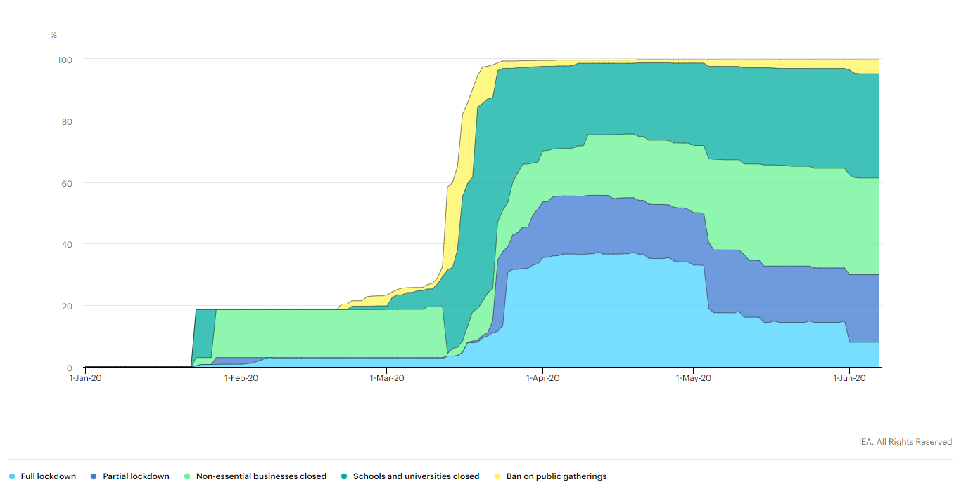
Share of global population under containment measures
As lockdowns ease, jobs are rebounding somewhat. Need for smart econ stimulus.
https://www.iea.org/reports/sustainable-recovery/covid-19-and-energy-setting-the-scene#abstract

Slide 13
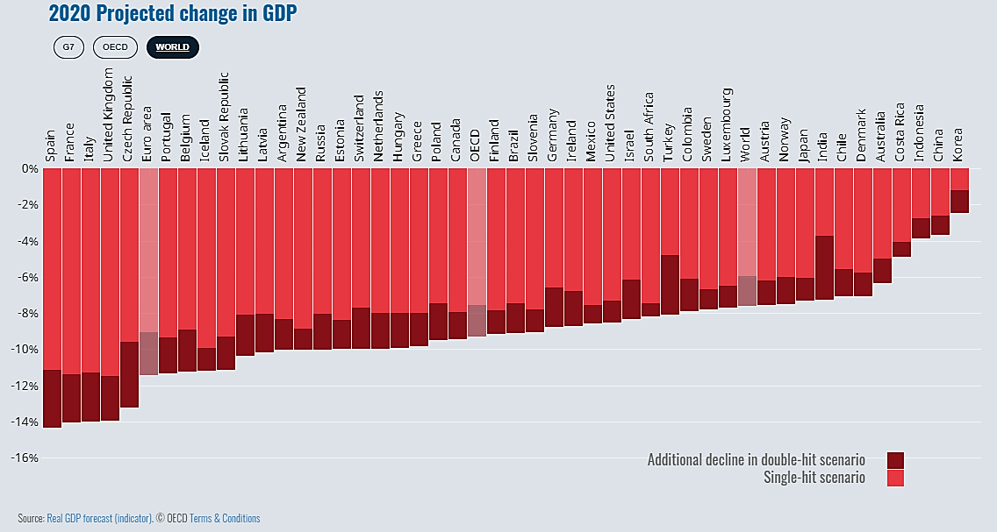
The OECD projects significant economic impacts in 2020
http://www.oecd.org/economic-outlook/june-2020/
Notes:
The OECD is predicting significant economic impacts in 2020.
As you can see, the global outlook shows significant declines in GDP in 2020 due to the Covid-19 crisis
The light red columns represent a single-hit, or single-wave Covid-19 scenario, and the dark red represents the further economic impact of a 2nd wave scenario
You can see that the selection of Latin American region is also expected to be impact by the crisis, as shown here with countries circled in yellow
[Screenshot from the OECD Website with yellow highlights emphasis added for available LatAm countries]

Slide 14
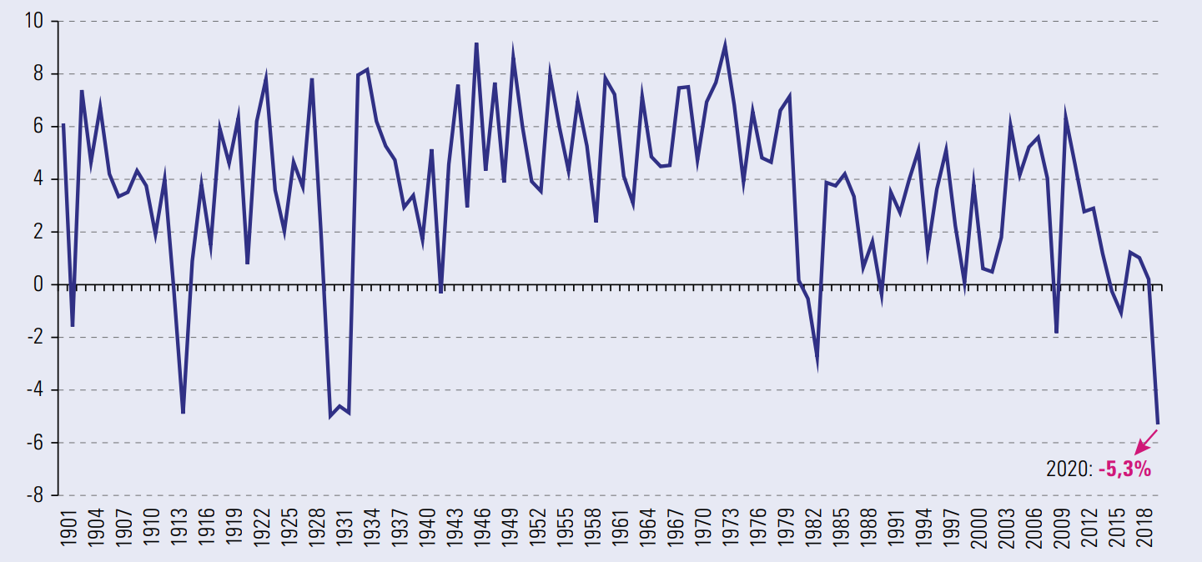
Latin America: annual GDP growth in real terms, 1901-2020
https://repositorio.cepal.org/bitstream/handle/11362/45445/1/S2000286_es.pdf
Notes:
And you can see here a snapshot of the long term economic figures for Latin America
As you can see, the impact in 2020 looks to be as severe an impact as we have seen over a 120 year period
Need to think about timing. EE jobs are local, can mobilize significant workforce quickly (lower to medium skilled jobs), can meet multiple objectives.

Slide 15
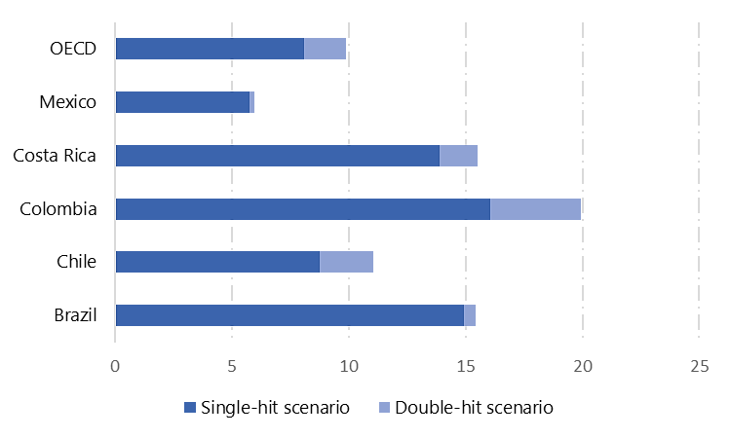
Unemployment forecasts show the need for policy action
OECD Unemployment Rate Forecast of single-hit and double-hit scenarios on % of labour force in 2021
Source: OECD Economic Outlook: Statistics and Projections
Notes:
Alongside impacts on GDP, there will also be impacts on employment
As you can see here unemployment rates will also be severely impacted by the Covid-19 crisis, with the OECD’s projected unemployment rates in the selected countries ranging from around 5 to 15% in 2021, with the single-hit scenario shown in dark blue, and the additional impact of a double-hit scenario in the light blue
[Michael has the data files saved if we want to reformat the graph]

Slide 16
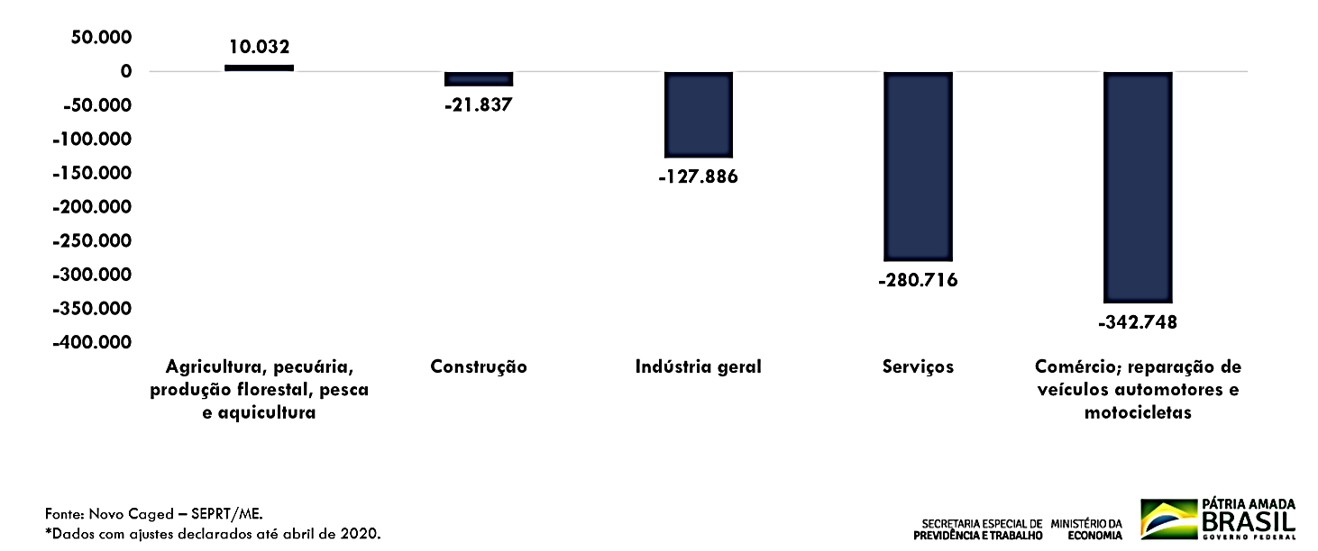
Significant job losses across sectors
Balance of formal jobs by economic activity in Brazil, January to April 2020
Source: Caged (Register of employees and unemployed) - Special Secretariat of Social Security and Labour under the Ministry of Economy
Notes:
Source: Caged (Register of employees and unemployed) - Special Secretariat of Social Security and Labour under the Ministry of Economy
The balance of formal jobs by economic group, from January to April 2020, assigns to the construction sector a number of - 21.837
Industry -127.886, Services -280.716, Commerce, repair of vehicles and motorcycles – 342.748

Slide 17
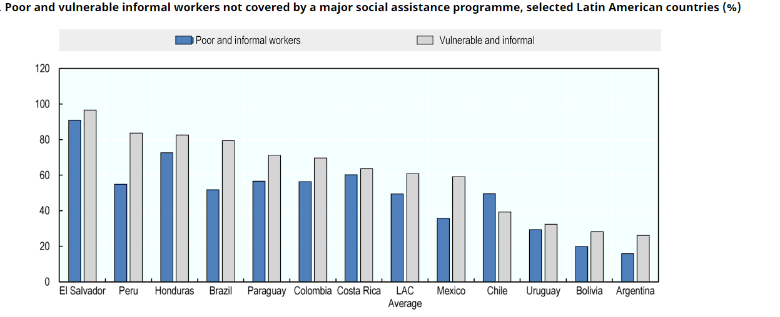
Many informal workers not covered by relief programmes
Poor and vulnerable informal workers not covered by major social assistance programme, select countries (%)
http://www.oecd.org/coronavirus/policy-responses/covid-19-in-latin-america-and-the-caribbean-regional-socio-economic-implications-and-policy-priorities-93a64fde/

Slide 18
Energy bills in the spotlight

Slide 19
Assistance for electricity and other utility payments
Argentina - The interruption of essential services suspend for 180 days for most vulnerable households, SMEs, cooperatives, institutions related to the health system and institutions for the public good.
Bolivia – government assistance for water, gas and electricity bills for households and small consumers, April – June.
Brazil - Suspension of electricity payments for low-income families. Social tariff assistance increased from up to 65% to 100% for first 220kWh.
Costa Rica - Opening of extraordinary terms for payment of electricity for businesses and industries.
Panama – Electricity bill reductions up to 1,000 kWh and suspension of payments for electricity, phone and internet for families and small businesses with low or incomes from April 1 to June 30, 2020.
Uruguay - Financing of 70% of electricity bills from April to November 2020, for hotels and restaurants. Payment exemptions for some schools and public spaces.
Paraguay - Exemption from paying electricity for households that consume less than 250 KWh per month for three months.
Colombia - The companies that provide the public service of electrical energy and gas may defer for a period of 36 months, the cost of basic or subsistence consumption.
https://app.powerbi.com/view?r=eyJrIjoiNTFkNDkxMGEtOWJjNS00ZGY3LWFkZDMtZTA1ZDhhNTdjNzZlIiwidCI6Ijg2M2UzOGFmLWFhNDctNDVjNy1hNTI1LTIwNDY1YzY1NDI0NCIsImMiOjR9

Slide 20
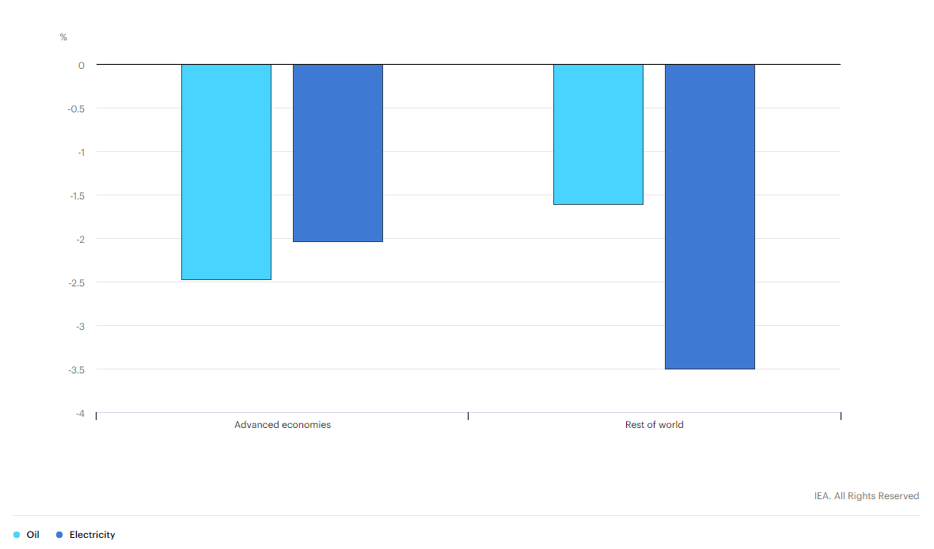
Opportunity to cut energy bills
Reduction in consumer oil and electricity bills as a result of the Sustainable Recovery Plan
https://www.iea.org/reports/sustainable-recovery
Notes:
Energy poverty and energy affordability is a critical concern for policy makers.
Assuming that prices remain unchanged, there would be important reductions in consumer bills by the end of the sustainable recovery plan compared with a case without this spending as a result of fuel switching and energy efficiency measures.
This can also provide a further jobs and economic boost, as in general, the average job-intensity of spending on energy utility bills is lower than spending in other sectors of the economy. So when households and businesses reinvest their energy savings, they will support more jobs.

Slide 21
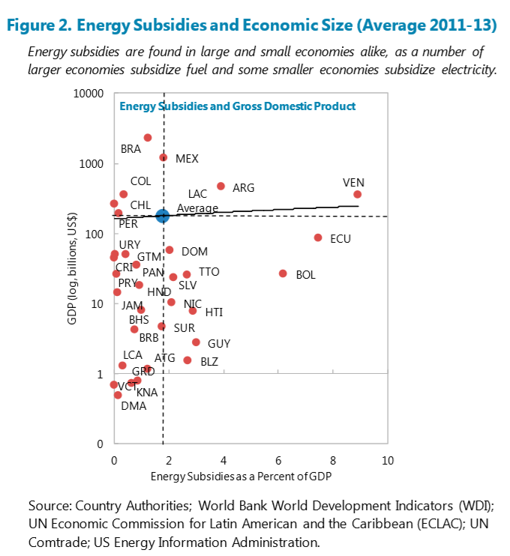
Huge potential to save by reducing subsidies
Energy subsidies for the average LAC country cost about 1.8 percent of GDP annually in 2011–13, about 1 percent of GDP for fuel and 0.8 percent of GDP for electricity .
Energy subsidies in LAC are not related to economic size. However, low-income countries provide relatively high subsidies as a share of GDP.
Energy subsidies in both the Central America and the Caribbean are predominantly provided for electricity.
Spending on subsidies reduces the availability of public resources for other purposes, which might have more positive distributional impacts — for instance, social spending.
Can also help transition out subsidies
https://www.imf.org/en/Publications/WP/Issues/2016/12/31/Energy-Subsidies-in-Latin-America-and-the-Caribbean-Stocktaking-and-Policy-Challenges-42708
Notes:
Address low oil prices – changes since 2013. Timing.
In 2019, the global value of fossil fuel consumption subsidies was around $320 billion. If there were to be no changes in pricing regimes, we estimate that total fossil fuel subsidies would fall to around $180 billion in 2020 because of the drop in oil and gas prices. However a number of countries have introduced additional price interventions, particularly in the electricity sector, to protect newly vulnerable consumers and so this number may increase.
the dramatic fall in oil and gas prices presents an opportunity to cut subsidies without increasing end-use prices. Phasing out fossil fuel subsidies would create new budget space and remove economic distortions thereby facilitating spending to flow to more productive uses and boost long-term economic growth
Introduce reforms in stages to avoid any abrupt or large price rises that may be difficult for some parts of the population to absorb.  Implement parallel reforms to protect vulnerable groups. For example, there might be a strong case for targeting conditional cash transfers to those who lack reliable access to clean cooking fuels and electricity (see section 2.4.3).  Accompany reforms with a comprehensive communication strategy that persuades citizens of the need for reform and that it is being implemented in a just manner.

Slide 22
Case study: how energy efficiency can generate government savings
Mexico: Cambia tu viejo por uno nuevo
Following 2008 financial crisis (2009-2018) the programme replaced air conditioners and fridges
Primary aim to reduce household electricity use, which was highly subsidised in over 95% of households.
Also an opportunity to reduce greenhouse gas emissions and safely dispose of refrigerant gases.
Nearly 2 million refrigerators and air conditioners were replaced resulting in estimated lifetime energy savings of over 6 770 GWh, or around 8% of annual residential electricity demand.
All replaced appliances were over 10 years old and in low-income households receiving the largest electricity subsidies.
The programme delivered energy subsidy savings of around $83.2 million a year due to energy efficiency improvements, with a payback period to government of under 4 years.
The programme delivered over 1 650 new permanent jobs and 10 650 temporary jobs across the supply chain, from manufacturing, to delivery and recycling.

Slide 23
Energy efficiency and the economic recovery

Slide 24
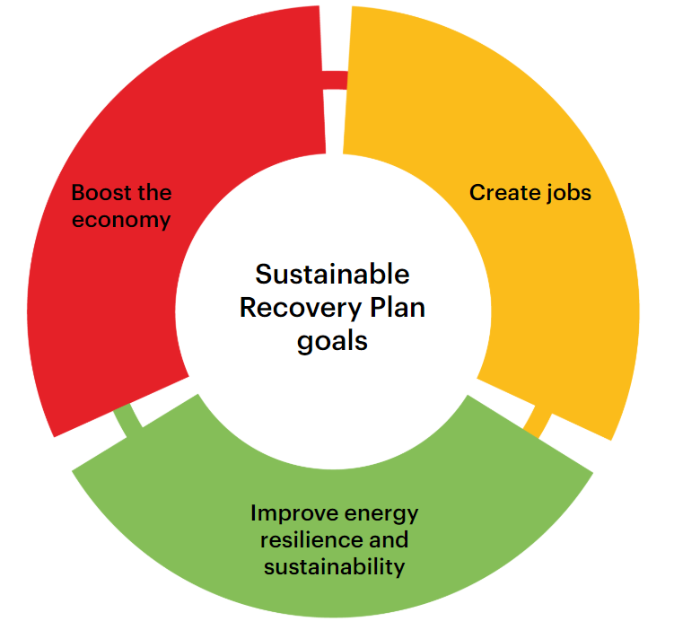
The IEA’s Sustainable Recovery Plan
Integrated goals of a sustainable recovery plan for the energy sector
https://www.iea.org/reports/sustainable-recovery
Notes:
Thankfully, it’s not all bad news, as there are a range of policy options available to governments today to deliver economic and sustainability benefits.
In developing the World Energy Outlook Special Report on a Sustainable Recovery the IEA has assessed a menu of over 30 energy-related measures for key sectors that policy makers could consider as part of a plan to boost economic growth and create new jobs while building a more sustainable and resilient energy sector.
For each measure we examined the impacts of the Covid-19 crisis on the sector, job creation potential, cost effectiveness, and CO2 emissions reduction potential
We have also suggested specific policies for consideration.
The Sustainable Recovery Plan for the energy sector, is designed to:
Boost the economy
Create jobs; AND
Improve energy resilience and sustainability of the energy sector

Slide 25
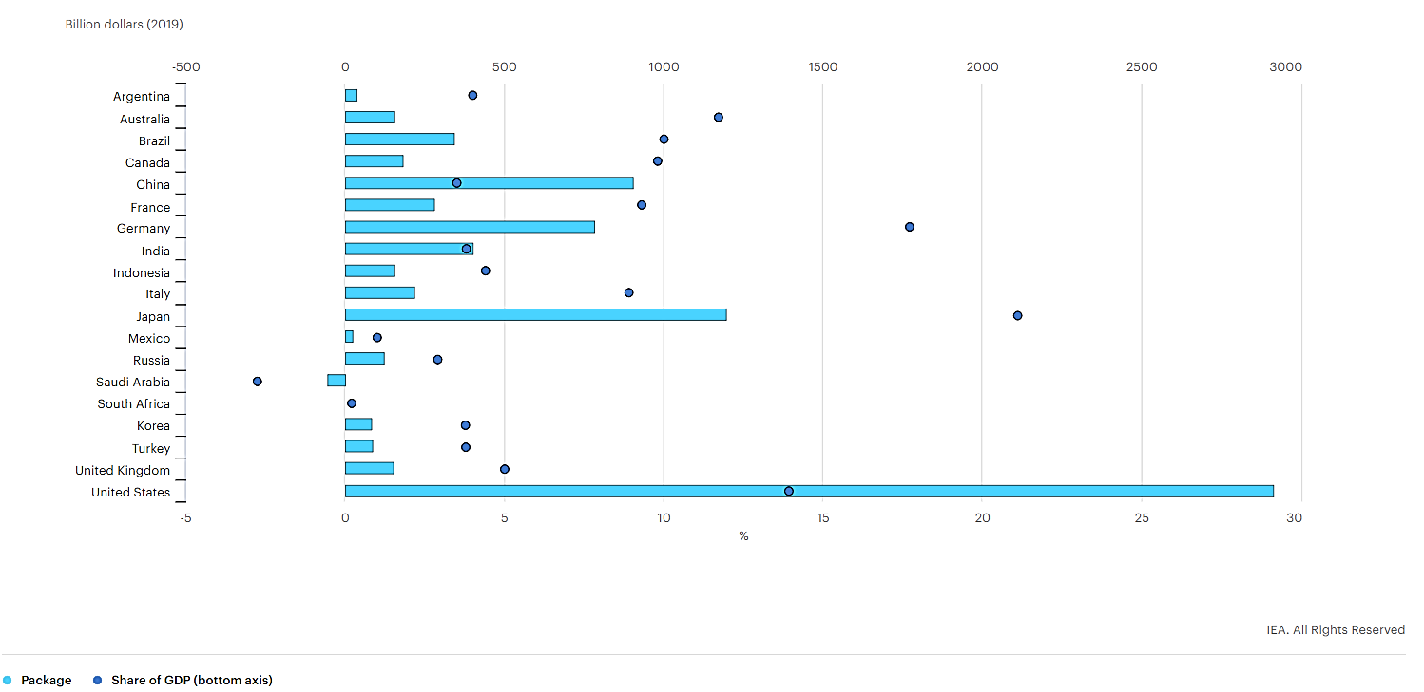
Emergency economic packages vary in size
Emergency fiscal measures announced by G20 countries in response to the Covid-19 crisis
Includes measures announced to 7 June 2020. US dollars are presented in 2019 purchasing power parities.
GDP is expressed in real terms.
In Saudi Arabia, fiscal consolidation measures correspond to a net negative package.
Sources: IEA analysis based on Elgin, Basburg and Yalaman (2020); IILS (2011).
https://www.iea.org/reports/sustainable-recovery/covid-19-and-energy-setting-the-scene#abstract
Notes:
Governments are already taking action on the emergency response
In G20 countries, emergency fiscal measures vary between -3% and 21% of GDP – similar to the large variation of final recovery plans after the 2008-09 financial crisis
You can see the variation is not just global, but also within the Latin American Region, with announced fiscal measures back on 7 June 2020 having a big range as a percentage of GDP
However, despite this variation, we can see - to date - many G20 nations have already committed stimulus measures representing around 5% or more of their GDP, with many countries expected to announce second rounds of packages

Slide 26
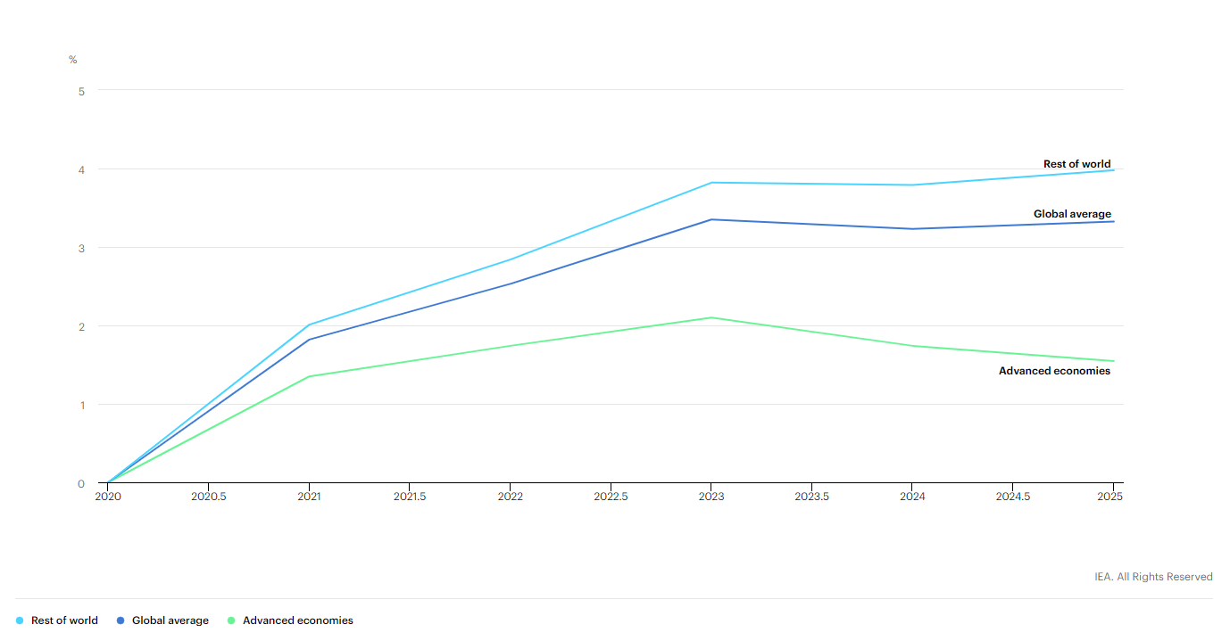
The IEA’s Sustainable Recovery Plan
Increase in real GDP as a result of the sustainable recovery plan, 2020-2025
https://www.iea.org/reports/sustainable-recovery
Notes:
The IEA’s sustainable recovery plan – with 1 trillion dollars of annual spending through 2023 – is estimated to lead to a 3.5% increase in real global GDP in 2023 above the level that it would have been without the spending.
In terms of annual changes in GDP, this means that global economic growth each year to 2023 would be 1.1% higher on average than it would have been otherwise.
And the boost to GDP is on average higher for emerging economies, than the boost to advanced economies

Slide 27
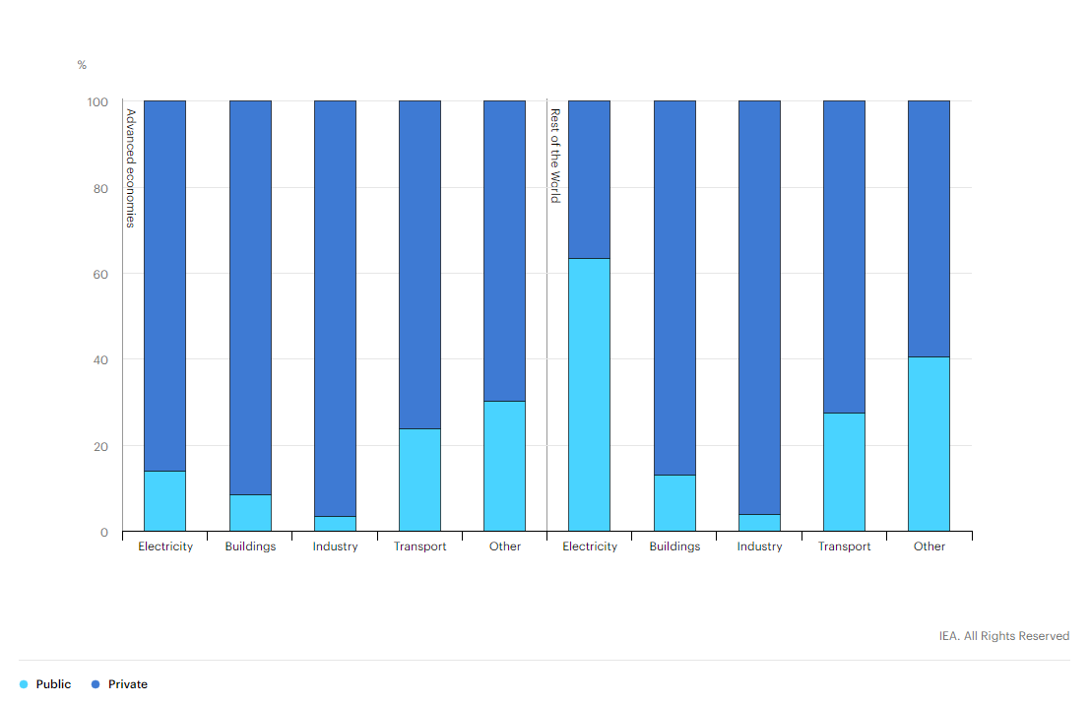
Policy leadership can unlock private capital
Annual public and private spending in the Sustainable Recovery Plan 2021-23
90 120 30 150 30 240 140 50 120 30 Billion dollars
https://www.iea.org/reports/sustainable-recovery
Notes:
Around 70% of the $1 trillion annual spending in the Sustainable Recovery Plan is expected to come from private investment sources, with direct public financial support and policy design critical to mobilising these funds
Our IEA and IMF analysis shows a greater need for government financial support in emerging economies, in order to unlock private investment, as a proportion of total investment (except in industry, where similar %s are required)
Policy makers should consider this in the design of sustainable recovery programmes in Latin America

Slide 28
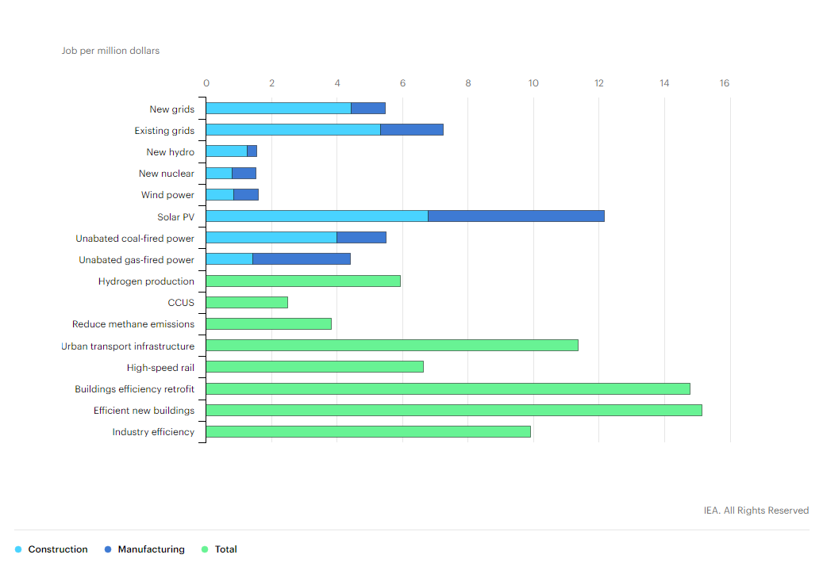
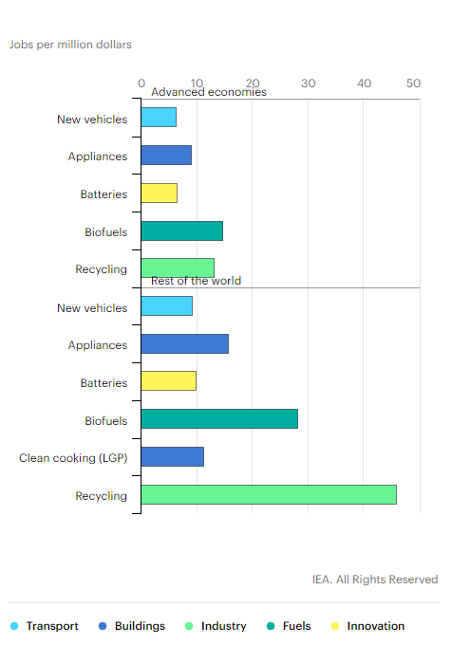
Investments in clean energy transitions are job intensive
Construction and manufacturing jobs created / $ million investment in the Sustainable Recovery Plan
Energy efficiency is a key ingredient for economic stimulus
https://www.iea.org/reports/sustainable-recovery
Notes:
And here is some more good news.
As the IEA’s Executive Director announced at our global conference the other day, energy efficiency is a “jobs machine”
While we can see the strong jobs benefits of investments in clean energy and grid infrastructure, you can see that investment in energy efficiency can deliver some of the strongest job support and creation potential as part of the clean energy transition
And as you can see on the right hand side, the jobs created per millions of dollars invested are higher for emerging economies than advanced economies

Slide 29

Energy efficiency employment multiplier effect
Brazil
4.38 X
In Brazil, for example, for every job created in construction, 4.38 are created in the total economy. This multiplier effect is 3.45 in Paraguay and 2.35 in Mexico.
Paraguay
3.45 X
Mexico
2.35 X
Source: ECLAC-ILO (2018). Employment Situation in Latin America and the Caribbean
https://repositorio.cepal.org/bitstream/handle/11362/44186/1/S1800885_en.pdf
Notes:
To explain this in a bit more detail…
Investment in any given sector or project type does not create jobs in isolation, but can create flow-on jobs throughout the supply chain
For example, ILO-ECLAC report "Employment Situation in Latin America and the Caribbean" from 2018 highlights mutlipliers for investment in the construction industry in Brazil, Paraguay and Mexico.
These figures demonstrate that an investment in construction projects is labour intensive, but that the jobs flow not just to the “direct jobs” on the construction site, but deliver “indirect jobs” throughout the manufacturing supply chains too.

Slide 30
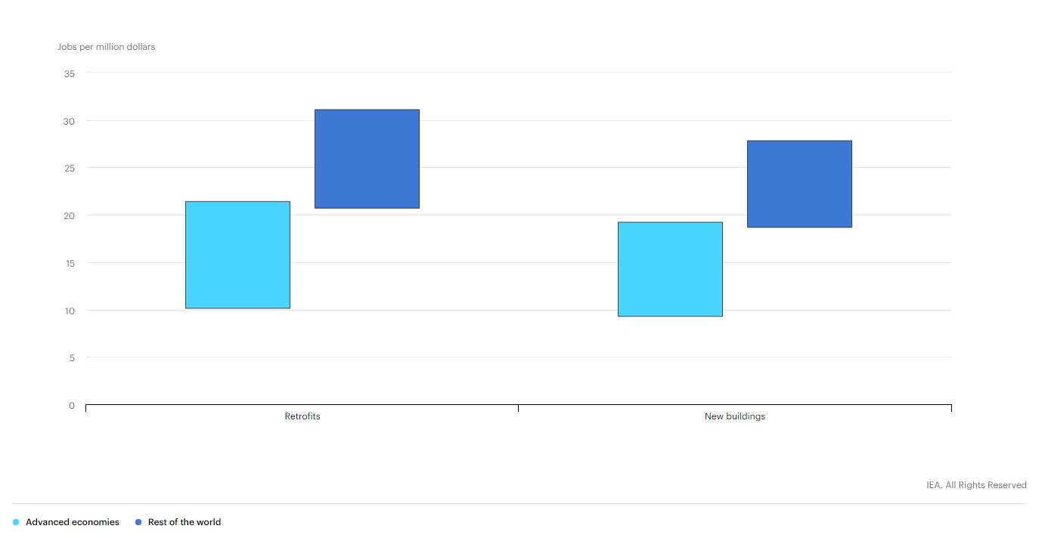
Energy efficiency is a “jobs machine”
Job creation potential to 2025 of investment in efficiency improvements in buildings
https://www.iea.org/reports/sustainable-recovery
Notes:
And what can this mean in terms of the amount of jobs you get per million dollars invested?
Investments in energy efficient retrofits and new construction are job intensive, as a significant proportion of the investment goes towards labour costs
The IEA estimates that for every USD $1 million invested in the buildings and construction sector, 9 to 30 jobs are created – with emerging economies delivering more jobs per $ million than advanced economies
Building and construction projects offer a number of benefits to economic recovery packages:
Speed - they offer shovel-ready projects – many have short lead-times from planning to delivery, helping to invest quickly
Scale - Building and construction, and the manufacturing supply chain, support a significant number of jobs – around 10% of the global workforce – this means investment in energy efficient buildings and construction can also achieve a significant scale at supporting existing, and creating new jobs
Local - building and construction projects also deliver distributional benefits as they create local jobs – for example a programme to build or upgrade schools or social housing can see local employment opportunities across every town in a country or municipality, whereas for many large infrastructure projects, employment opportunities depend on the single location of the project. You can also find similar distributional benefits for distributed renewables, such as rooftop solar PV installations
Social equity - Public building upgrades, whether for public housing, hospitals or schools, provide a ready to go pipeline of energy efficiency opportunities to create jobs while reducing government’s energy costs. And they also help to provide essneitla services – housing, health and education to those most in need

Slide 31
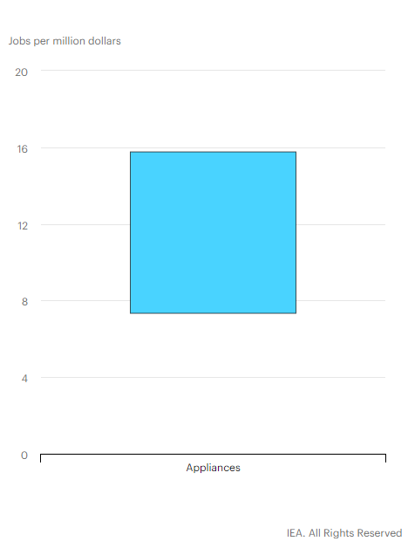
Energy efficient appliances also deliver jobs
Jobs created for investment in appliances
https://www.iea.org/reports/sustainable-recovery
Notes:
We estimate that 7-16 jobs would be created for every million dollars spent on energy efficient appliances, of which the majority would be in distribution and sales.
This job creation effect is strongest when appliances are manufactured locally.
And when policy makers design programmes to replace and recycle the old appliance, the collection and recycling industry jobs provide a further economic boost
Replacing old devices with new high efficiency appliances would cut consumer spending on electricity by around 30-50%
A small subsidy could significantly reduce payback periods for consumers, accelerating the uptake of efficient appliances and reducing consumer bills.
Bill savings are usually re-invested in more productive and labour-intensive sectors of the economy than the energy utilities sector.

Slide 32
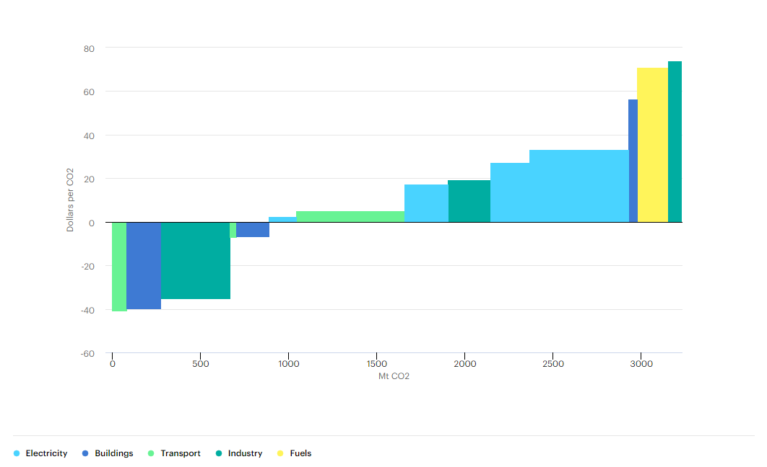
Industry is a crucial sector for the clean energy transition
Emissions avoided as a result of the Sustainable Recovery Plan
https://www.iea.org/reports/sustainable-recovery
Notes:
Industrial energy efficiency remains a critical sector in the clean energy transition
This chart shows how much negative cost abatement the industrial sector offers as part of the Sustainable Recovery Plan
And industrial energy efficiency delivers other benefits too, delivering jobs, supporting industries and their entire supply chains (which often include a lot of SMEs), improving their energy productivity and competitiveness, while at the same time improving energy resilience by reducing the demand requirements of energy-intensive industrial loads
Industrial energy efficiency delivers around 10 jobs per $ million invested

Slide 33
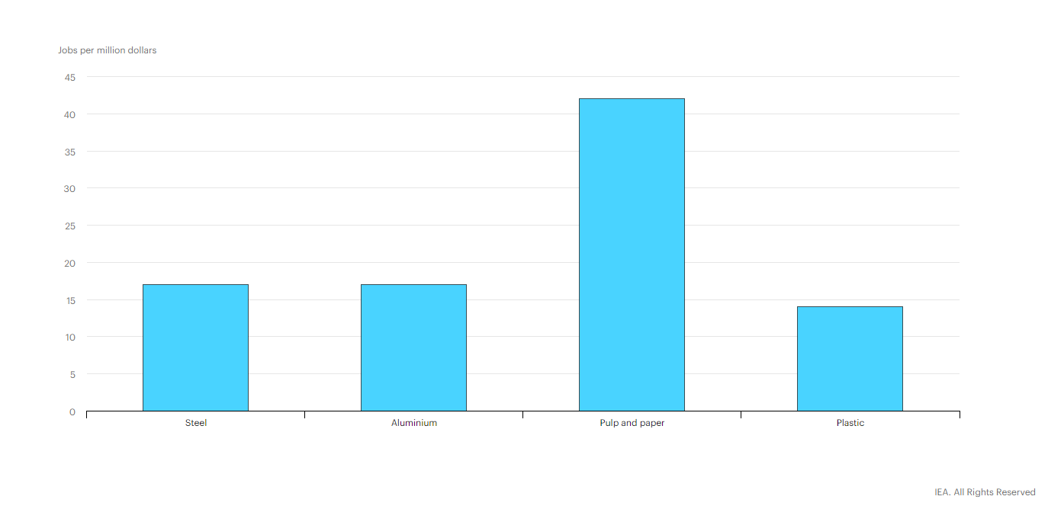
Recycling is a particularly strong opportunity
Net job creation of recycling /$ million spending in the Sustainable Recovery Plan
Energy Efficiency scrappage and upgrade programmes can also deliver recycling jobs
https://www.iea.org/reports/sustainable-recovery
Notes:
Waste and material recycling has large job creation potential, especially in developing countries
In emerging economies recycling industries create around 15-40 jobs per million dollars of investment
In developing economies, where 15-20 million waste pickers work in the informal sector, progress could be made by equipping municipalities with the financial resources to take ownership of waste management and encouraging the installation of new waste collection and sorting technologies and adopt best practices for collection.
This would deliver benefits in terms of employment, health, environment and reduced GHG emissions.
Increasing global average recycling rates (for all materials) from around 41% today to 47% in 2030 would reduce emissions from material production by around 20% from current emissions levels

Slide 34
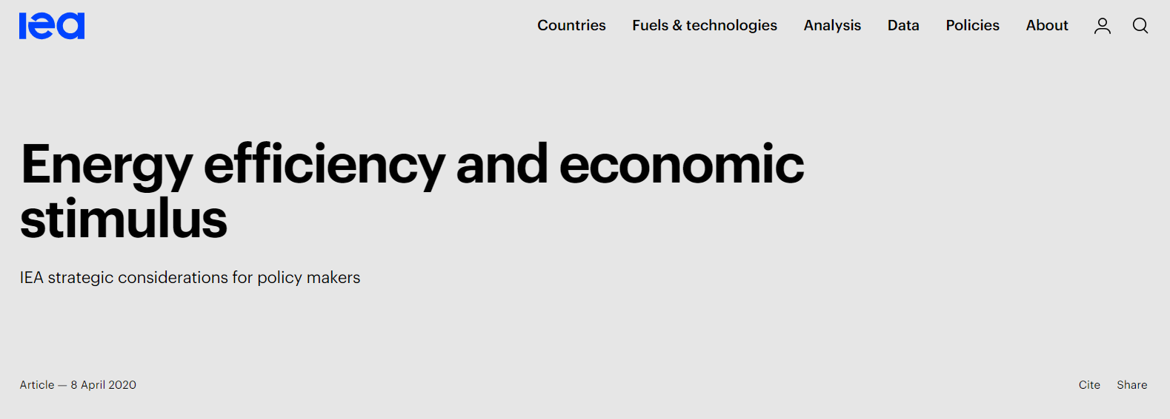
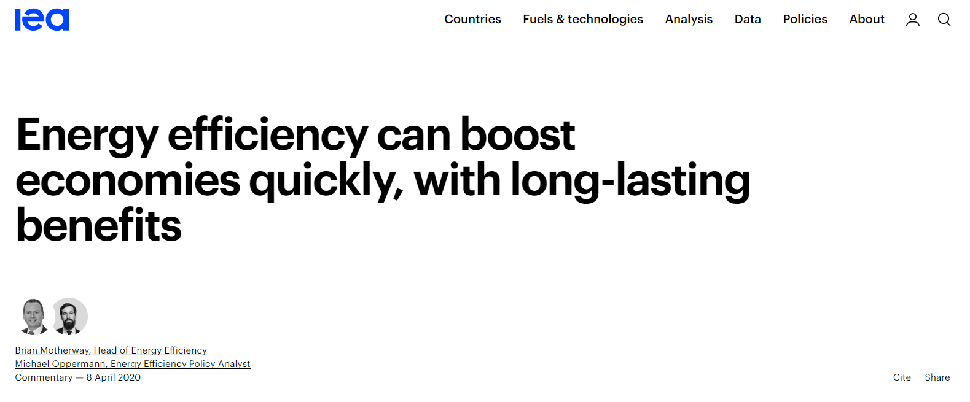
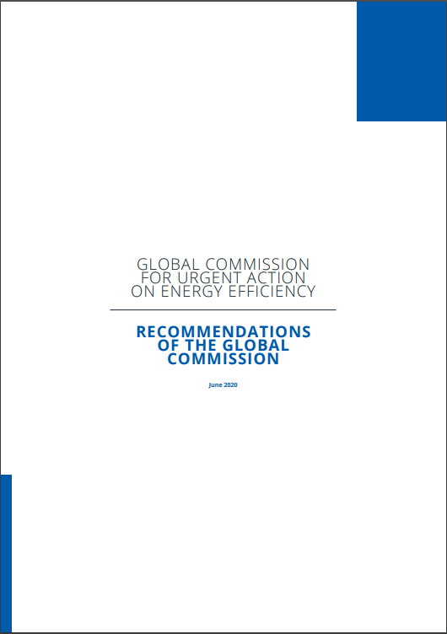
Policy recommendations
Leverage existing programmes, contracts and eligibility criteria to deliver packages at scale and speed
Develop a strong pipeline of new projects
Turn short-term impacts into long-term transformations
Tailor support for distressed industries
Mobilise private investment
International co-operation
Notes:
Governments can deliver stimulus at scale and speed by leveraging existing programmes and standardising designs, eligibility criteria and contracts; choosing shovel-ready options for retrofits and technology upgrades; and considering how energy efficiency can be built into all government stimulus programmes.
Develop a strong pipeline of new projects – by expanding existing programmes, fast-tracking programmes already being designed, and supporting the market through government investment in public or social housing, and other public building and infrastructure upgrades.
Turn short term impacts into long-term transformation – locking in both a step-change in the clean energy transition & maintaining a larger amount of jobs after economic stimulus packages end – by introducing and raising energy efficiency standards alongside or following subsidies for specific sectors and technologies as part of recovery packages. This will help to soften boom-bust cycles that can occur from short-term subsidy and stimulus programmes
Tailor support for distressed industries. Some sectors severely impacted by the Covid-19 crisis are likely to require government support to continue operations. A number of countries have announced support packages for their construction, vehicle manufacturing and airline industries, for example. Governments could make support for these industries conditional on progress towards long-term sustainability and resilience.
Mobilising private investment - Part of the sustainable recovery plan will need to be funded through direct government expenditure. One of the five key policy pillars of the sustainable recovery plan is the mobilisation of private financing to complement the direct government expenditure. Public policies have an essential part to play in facilitating the deployment of private capital through regulations, market frameworks and tax reforms.
International co-operation. There would be significant co-ordination gains if countries align their actions. For example, if a group of countries deploy a particular clean energy technology, its costs are likely to fall faster than if only one country deploys it, to the benefit of all. Cross-border collaboration could also be useful in helping to re-establish some international supply chains disrupted by the Covid-19 crisis. Consider the role international finance could also play to support the economic recovery and the clean energy transition

Slide 35






Global Commission for Urgent Action on Energy Efficiency
The commission has 23 members and is composed of national leaders, current and former ministers, top business executives and global thought leaders.
Notes:
Honorary chair : H.E. Mr. Leo Varadkar, Prime Minister of Ireland
Ongoing chair : H.E. Mr. Richard Bruton, Minister of Communications, Climate Action and Environment, Ireland
21 other members from a variety of backgrounds:
7 current ministers and senior government representative, 4 previous ministers, business executives and thoughts leaders
(Counting)
9 current ministers and senior government representative
Aziz Rabbah
Claude Turmes
Leo Varadkar
Richard Bruton
Teresa Ribera Rodriguez
Megan Woods
Salome Zourabichvli
Secretary Cusi
Minister Suarez
4 former ministers
Kandeh Yumkella
Wan Gang
Jurgen Trittin
Connie Hedegaard

Slide 36
Recommendations of the global commission
Prioritise cross-cutting energy efficiency action for its economic, social and environmental benefits
Act to unlock efficiency's job creation potential
Create greater demand for energy efficiency solutions
Focus on finance in the wider context of scaling up action
Leverage digital innovation to enhance system-wide efficiency
The public sector should lead by example
Engage all parts of society
Leverage behavioural insights for more effective policy
Strengthen international collaboration
Raise global energy efficiency ambition

Slide 37
The role of cities

Slide 38
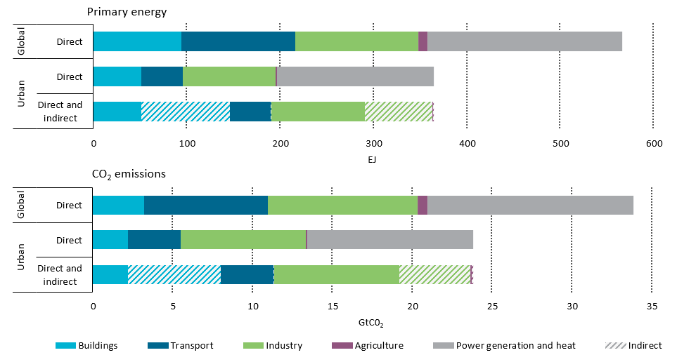
Why is urban energy use so important?
The majority of global energy use and greenhouse gas emissions are concentrated in urban areas. But policy levers are shared across different levels of government.
Source: IEA Energy Technology Perspectives 2016: https://www.iea.org/reports/energy-technology-perspectives-2016
Notes:
Given their high concentrations of population and economic activity, the world’s urban areas play a dominant role in global energy use. Global urban areas represent about two-thirds of global primary energy use.
From a sectoral perspective, direct fuel use by the power sector accounted for the largest share of urban primary energy use, followed by direct fuel use by the buildings (residential and services combined), industry and transport sectors within urban areas.
When direct fuel use by the power sector is distributed to end-use sectors on the basis of their consumption of electricity and heat, the buildings and industry sectors emerge as the largest total contributors to urban primary energy use, followed by the transport sector.
CO2 emissions attributable to the world’s urban areas are estimated at 70% of the global total.

Slide 39
Why cities?
Share of global population living in urban areas projected to rise from 54% today to 64% in 2040 – equivalent to 78 million additional urban dwellers on average each year, predominantly in emerging and developing economies.
About one third of urban energy GHG mitigation potential is in the hands of national governments, one third local governments; and one third shared.
National governments cannot drive clean energy transitions on their own: local governments & collaborative action across tiers of government play a critical role (e.g. building codes, distributed RE, EV charging infrastructure, mass transit).
This is more relevant than ever in the current Covid-19 crisis and the global call for sustainable recovery action supported by the IEA’s work.
Notes:
New analysis by the Coalition for Urban Transitions finds that, worldwide, national and state governments have primary authority over 35% of urban mitigation potential (excluding decarbonisation of electricity), including from improved cement production processes and more stringent efficiency standards for appliances, lighting and vehicles. Local governments have primary authority or influence over 28%, including compact urban form, travel demand management and waste disposal. 37% of the identified mitigation potential depends on collaborative climate action among national, regional and local governments, including building codes, decentralised renewables and mass transit infrastructure, EV charging infrastructure.

Slide 40
Latin American cities at the heart of the sustainable energy transition
Latin America is currently the second most urbanised region in the world. The share of its urban population rose from 71% in 1990 to 81% in 2011 and is expected to reach 86% by 2050.
26% of the urban population in LAC lives in poverty or extreme poverty and approximately 160 million people live in informal settlements.
Socio-economic inequalities are manifest in the urbanisation patterns of Latin American cities, often in the form of socio-spatial segregation.
The poor often have to resort to constructing self-help housing situated on the fringes of cities. Informal settlements are generally built in residual unoccupied or outlawed urban spaces, i.e. those at greatest risk of natural hazards and climate impacts (flooding, landslides, etc.).
As a result, in Latin America, urban planning is at the intersection of social and spatial equity. This has important implications in the framing of sustainable energy interventions.
Notes:
Latin America and the Caribbean (LAC) is currently the second most urbanised region in the world. The share of its urban population rose from 71% in 1990 to 81% in 2011 and is expected to reach 86% by 2050.
Twenty-six percent of the urban population in LAC lives in poverty or extreme poverty and nearly one in four people lives in slums. By 2020, 160 million people are expected to live in informal settlements.
Currently, it is estimated that 75% of housing built annually in the region is informal, which means that these dwellings lack property titles and access to basic infrastructure and services (World Bank, 2017). I will come back to this on the next slide.
Socio-economic inequalities are manifest in the urbanisation patterns of Latin American cities, often in the form of socio-spatial segregation. The poor often have to resort to constructing self-help housing situated on the fringes of cities and “in the interstices of formal development” (Irazábal, 2009). As a result, informal settlements are generally built in residual unoccupied or outlawed urban spaces, i.e. those at greatest risk of natural hazards (flooding, landslides, etc.).
As a result, in Latin America, urban planning places strong emphasis on the intersection of social and spatial equity. This has important implications in the framing of sustainable energy interventions.

Slide 41
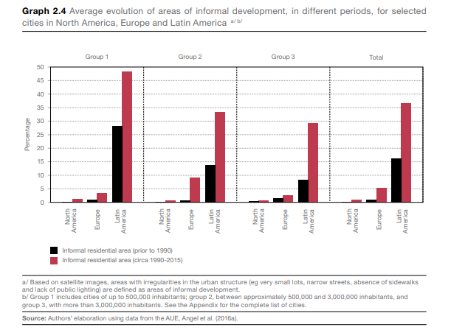
Important characteristic of Latin American cities: informal housing
Urbanisation has been accompanied by urban sprawl and fragmentation, with expansive areas of informal settlements in cities.
Currently 75% of housing built annually in the region is informal, which means that these dwellings lack property titles and access to basic infrastructure and services.
http://www.oecd.org/coronavirus/policy-responses/covid-19-in-latin-america-and-the-caribbean-regional-socio-economic-implications-and-policy-priorities-93a64fde/
Unplanned urbanisation and informal housing represent challenges for urban planners and policymakers, for instance in the implementation of building standards.
Notes:
Urbanisation has been accompanied by urban sprawl and fragmentation, with expansive areas of informal settlements in cities.
Currently 75% of housing built annually in the region is informal, which means that these dwellings lack property titles and access to basic infrastructure and services.
This has posed challenges for urban planners and policymakers, for instance in the implementation of building standards.
This will have important implications in the post covid crisis and recovery.
An important part of the regional context impacting the buildings and construction sectors, are the dynamics of the labour market. In the Latin American region, informal labour represents a significant proportion of the labour force, especially in the building, services and construction sector. Around 60% of the construction workers are either self-employed or salaried workers in small establishments.
In the context of a highly informal and decentralised construction sector, awareness and expertise in low carbon building is often lacking and difficult to develop. Ensuring the capacity building for these professions would be one of the main priorities in order to achieve the net-zero target.

Slide 42
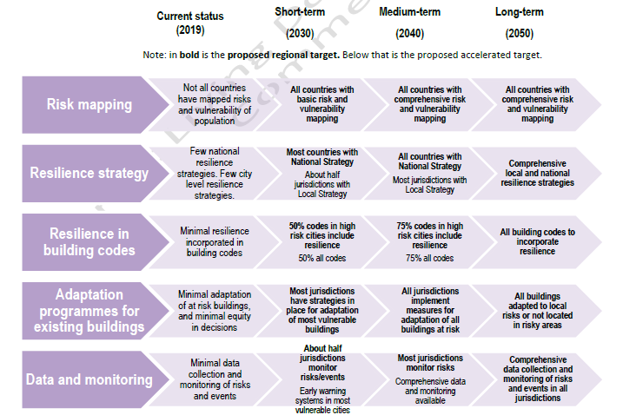
Recovery efforts key to make Latin American cities more resilient
Making cities as well as the infrastructure and regions connecting them resilient is a significant priority because the LAC region is particularly vulnerable to climate change.
The economic cost of climate change in the region has been estimated at as high as USD 100 billion.
Over 50% of the region’s population lives in countries with “high or extreme climate vulnerability risks”.
Source: Draft Global ABC/IEA Latin America Roadmap for Buildings and Construction, 2020
These factors, in light of the current Covid crisis, underline the importance to create buildings, cities and infrastructure that are resilient from an energy, climate and social perspective.
Notes:
These factors, in light of the current Covid crisis, underline the importance to create buildings, cities and infrastructure that are climate resilient.
Investment in enhancing and localelectricity grids, increasing energy efficiency would improve electricity security by lowering the risk of outages, boosting flexibility, reducing losses and helping integrate larger shares of variable renewables such as wind and solar PV.

Slide 43
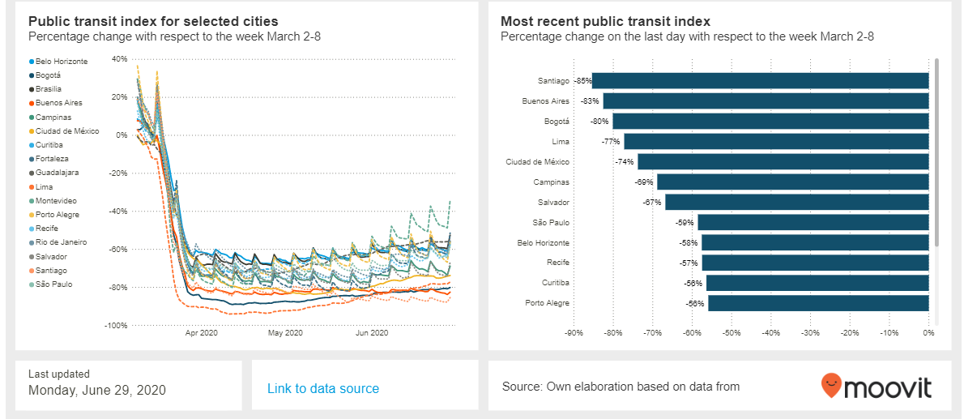
Impact of Covid lockdown on regional public transit systems
Source: https://www.iadb.org/en/topics-effectiveness-improving-lives/coronavirus-impact-dashboard
Notes:
Not just air quality. Multiple benefits. Ridership went down up to 75% in many large Latin American cities but operating costs are fixed which pose huge challenges in terms of financial viability. And these systems are the backbones of cities socio-economic activity. Access to jobs and services.

Slide 44
The role of local governments in economic recovery programmes
Highlights
Local and subnational governments can play an important role in stimulus packages
More than just as delivery agencies but as genuine partners – they own and operate municipal buildings and infrastructure which can be the focus of upgrade programmes
Unprecedented opportunity for carbon-lock out in the urban environment through infrastructure spending
Vertical alignment across all levels of government is crucial for effective economic recovery, addressing divergences among federal, state and local governments and lack of resources
Local and regional governments play a crucial in the rollout of street lighting; school, hospital and social housing retrofits; transport energy efficiency programmes and EV charging infrastructure deployment
Possible approach
  Build-up capacity within existing federal, state, and local government agencies
  Enable more effective delivery capabilities of cities through mainstreaming, direct funding and scaling of programmes that can be effective immediately
  Improve policies and regulations where necessary, and address major barriers and bottlenecks
  Harness cities’ innovative capabilities through new business models and community initiatives

Slide 45
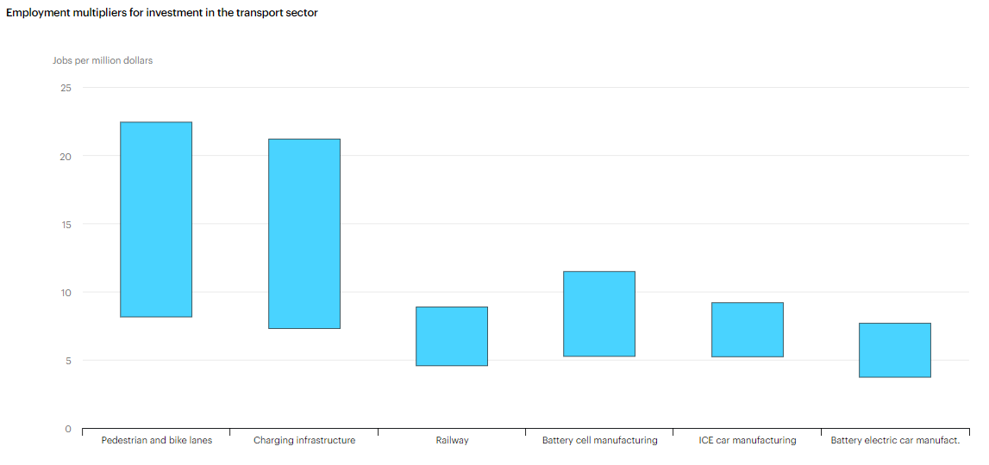
Urban transport crucial for sustainable recovery
Employment multipliers for investment in the transport sector
Charging points and bike infrastructure have large employment multipliers, in particular at the local/city level.
Source: IEA, WEO SR 2020: https://www.iea.org/reports/sustainable-recovery
Notes:
Improve urban infrastructure: Walking and cycling has significantly increased since the outbreak of Covid-19, and many cities have reallocated road space to pedestrians and cyclists. However the use of public transport in cities worldwide has fallen by 50-90%, with billions of dollars of revenue losses for operators (Moovit, 2020).
Globally, the public transport sector employs about 13 million people and plays an important role in ensuring accessibility for citizens in many cities (UITP, 2011).
Without government assistance, there is a risk that jobs could be lost, operations curtailed and prices raised. Any resulting modal shift to cars would increase GHG and air pollutant emissions as well as congestion levels.
Investment in public transport systems, including the electrification of city bus systems, would create around 30% more construction and engineering jobs than a similar level of investment in roads (Smart Growth America, 2011).
Public health fears could be addressed by investing in heightened cleaning practices on public transport and by appropriate social distancing measures.
New vehicles: The automotive sector directly employs around 11 million workers globally and supports a further 4 million indirect jobs (for parts manufacturing).
Car sales are expected to fall globally by around 15% in 2020 and commercial vehicles production by 22% (IHS, 2020a).
Consumer incentives for the replacement of old, inefficient vehicles by new, more energy efficient ones are a way of sustaining production facilities.
In addition to job retention, these incentive schemes, if designed appropriately, can reduce local air pollution and GHG emissions.
The shift to electric mobility creates local jobs downstream in the installation and O&M of charging points (AIE, 2018)

Slide 46

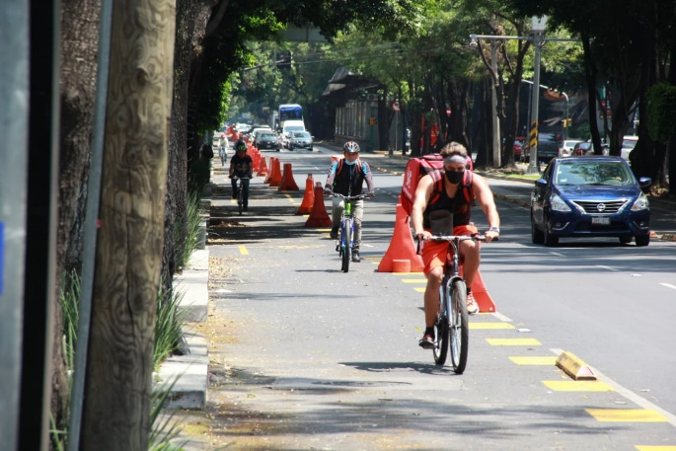
Importance of cities in energy transitions: Mexico City
Mexico’s Sustainable Transport Strategy includes a special focus on the public transit system.
Now investing more in lowest-income zones, since they spend the most time in transportation. Building 4 cable bus to link with subway system, up to 38 km in 4 different boroughs.
Metrobus expanding with 6 new routes that include improvements in EE compared to the old lanes. 20km added to link rural southernmost part of the city. Metro is catching up on maintenance in system.
Trolleybuses: 500 new units. Represent large share of public transport system, EE measures focus on good quality maintenance.
60 new 100% electric buses on one of most busy area. 2,000 users an hour during rush hour. Tripling bike lanes from 200 to 600 km.
Finally expanding hybrid and electric vehicle incentives for taxis, through innovative financial mechanisms.
Notes:
Mexico’s Sustainable Transport Strategy, with special focus on public transport system. Sector that emits the most GHGs is transport. 70%, followed by electricity use. 80% from residential, industrial and commercial within electricity use. Quite a lot still from fossil fuel sources. Has changed on how the city prioritizes infrastructure upgrades.
Now investing more in lowest-income zones, since they are the ones that spend the most time in transportation. Living in outer boroughs. Specific focus on accessiblity. Building 4 cablebus to link with subway system, up to 38 km in 4 different boroughs.
Also have the metrobus expanding with 6 new routes that include improvements in EE compared to the old lanes. 20km added to link rural southernmost part of the city. Metro is catching up on maintenance in system and E system. Trolleybuses: 500 new units. Most of public transport system, EE measures are related to good quality maintenance. Seems simple and easy, but actually maintenance measures improve EE by a lot.
Another example is 60 new 100% electric buses on one of most busy area. 2,000 users an hour during rush hour. Tripling bike lanes from 200 to 600 km. Finally expanding hybrid and electric vehicle incentives for taxis, through innovative financial mechanisms.

Slide 47

Sustainable recovery opportunities in municipal services: street lighting
Buenos Aires started a replacement programme in 2013, and in 2019 became the first metropolis in Latin America to use 100% LED lights for street lighting.
LED lights can reduce electricity consumption by 50%, e.g. some 85,000 KW per year, and lower the emission of CO2 by 44,000 tons per year.
In 2013, when the programme began, Buenos Aires had 125,000 luminaires and today there are 160,000 LED lights installed. All public lighting is operated from a centralized control panel that has information updated to the minute.
This technology called Interact City was designed by Signify (former Philips Lighting), according to local government data annual expenses on repairs cut by 30%.
Notes:
https://www.linkedin.com/pulse/argentina-buenos-aires-1st-city-100-led-street-latam-aldo-leporati/
Buenos Aires started a replacement programme in 2013, and in 2019 became the first metropolis in Latin America to use 100% LED lights for street lighting. According to official data, this technology can reduce electricity consumption by 50%, e.g. some 85,000 KW per year, and lower the emission of CO2 by 44,000 tons per year.
In 2013, when the program began, Buenos Aires had 125,000 luminaires and today there are 160,000 LED lights installed. All public lighting is operated from a centralized control panel that has information updated to the minute. It also detects faults and schedules repairs.
This technology called Interact City was designed by Signify (former Philips Lighting), and according to local government data, claims have been reduced by 40% and annual expenses on repairs were cut by 30%:

Slide 48
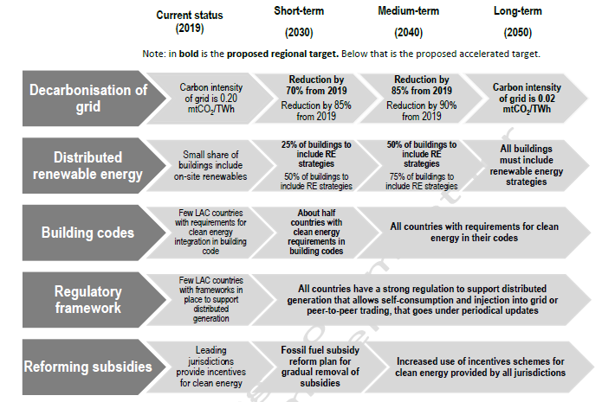
Key policy areas for sustainable urban energy in the built environment
Source: Draft Global ABC/IEA Latin America Roadmap for Buildings and Construction, 2020
Cities are the largest centres of energy demand with potential to generate on-site electricity to use later in an efficient way (e.g. load shifting, demand response). Likewise, integration of distributed RE generation diversifies the energy mix and creates employment opportunities.
Notes:
Buildings represent a great opportunity to facilitate clean energy transitions in emerging economies. Urban areas are the largest centres of energy demand and the capacity to generate resources on-site to use them later in an efficient way is an important step forward to reduce dependence on fossil resources. Likewise, a wide integration of distributed generation diversifies the energy mix (and the risk at the same time), opens up markets around energy services, reduces negative environmental impacts and creates employment opportunities. New energy services provided by buildings, such as demand response and energy storage (i.e. smart grid services and thermal storage) play an important role in meeting zero carbon goals as well.

Slide 49
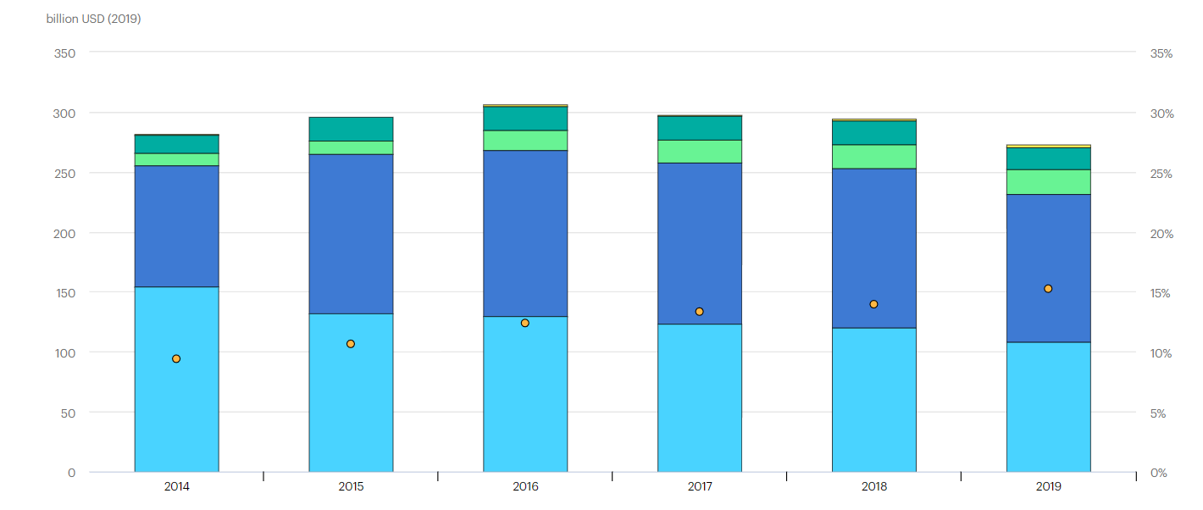
Smart grids can enable demand flexibility at the city & end-user level
Investment in smart grids by technology area, 2014-2019
In 2019, investment in electricity grids declined for the third consecutive year, by 7% compared with 2018 levels, falling under USD 280 billion. Electricity networks are the backbone of today’s power systems and even more important in clean energy transitions, but investment needs to pick up, especially at the local level.
Notes:
Electricity grids, the backbone of secure and reliable power systems, would see a 40% increase in investment after years of decline. This would put them on a stronger footing to withstand natural disasters, severe weather and other potential threats.

Slide 50
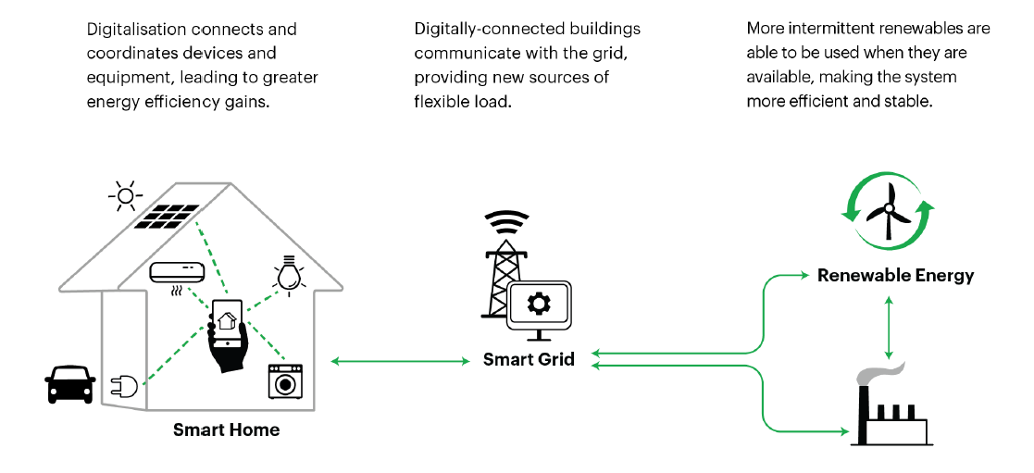
Digitalisation empowering systems thinking
Digitalisation, with the right policies, enables a progression to optimising the efficiency of the whole system and enabling optimum distributed energy systems.
Source: IEA Energy Efficiency Market Report 2019: https://www.iea.org/reports/energy-efficiency-2019
Notes:
Digitalization can help integrate variable renewables by enabling grids to better match energy demand to times when the sun is shining and the wind is blowing.

Slide 51
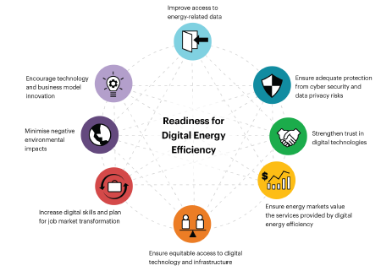
Policy is key to accelerate digitalisation for energy efficiency
Policy principles comprising the Readiness for Digital Energy Efficiency framework
Source: IEA Energy Efficiency Market Report 2019: https://www.iea.org/reports/energy-efficiency-2019
Notes:
So In the context of grid resilience & security and to ensure progress along a trajectory of decarbonisation and electrification – the role of demand side resources in providing services to the electricity system needs to grow.
In terms of benefits – there are also clear benefits from an economic recovery perspective where investments in grid modersnisation and decarbonisation come out at the top of options with significant job creation opportunities – coupled with long-term benefits and cost-effective reduction of green house gas emissions
A lot of these synergies physically take place in cities.

Slide 52
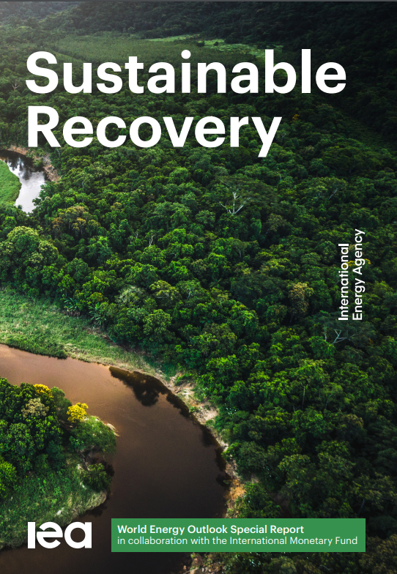
IEA analysis on Covid-19 relief and recovery
https://www.iea.org/articles/energy-efficiency-and-economic-stimulus
https://www.iea.org/commentaries/energy-efficiency-can-boost-economies-quickly-with-long-lasting-benefits
https://www.iea.org/reports/recommendations-of-the-global-commission-for-urgent-action-on-energy-efficiency
https://www.iea.org/reports/sustainable-recovery
Notes:
Mention survey and Q&A

Slide 53


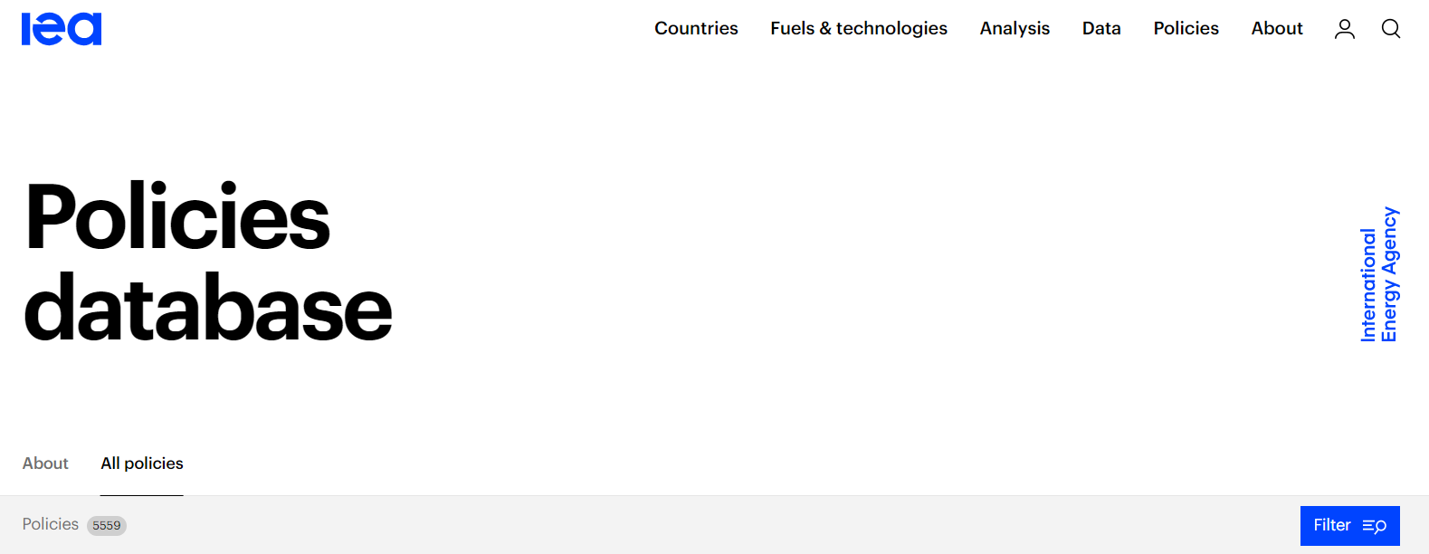
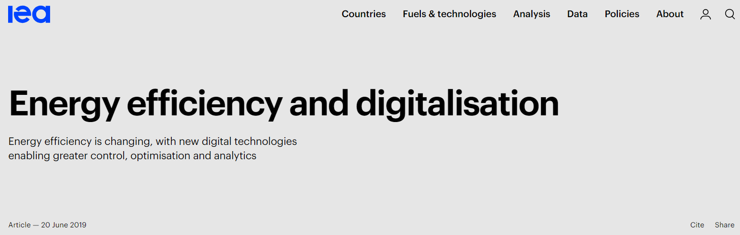
Other resources
Online courses – Energy Efficiency Indicators
- Essentials for Policymakers
- Fundamentals of Statistics
English / Portuguese / Spanish
Course in Spanish ongoing
Portuguese course expected last trimester 2020
40 hour course; free of charge
Open to everyone; enrol any time
https://es.edx.iea.org/courses
https://www.iea.org/articles/energy-efficiency-and-digitalisation
www. iea.org/policies

Slide 54
Energy.Efficiency@iea.org

