Slide 1
Oil 2023 Launch
石油2023报告发布
2023年6月20日

Slide 2
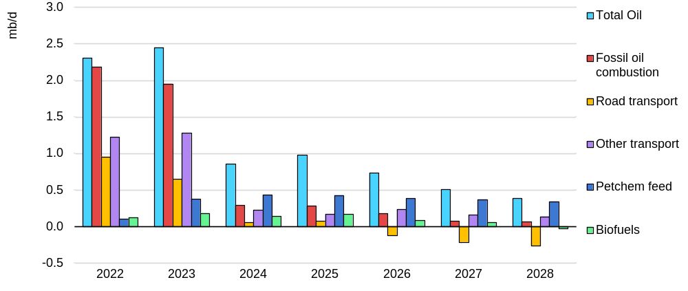
Global energy crisis accelerates transition away from oil
全球能源危机加速了与石油脱钩的过渡
Annual oil demand growth, 2022-2028
年度石油需求增长，2022-2028年
石油总量
化石燃料燃烧
公路运输
其他运输
石油化工原料
生物燃料
Growth in oil demand will slow from 2.4 mb/d in 2023 to 400 kb/d in 2028. Fossil fuel combustion peaks in 2028 on rising efficiencies and EV sales. Petrochemical feedstocks continue to increase.
石油需求的增长将从2023年的2.4百万桶/日放缓到2028年的400千桶/日。由于效率的提高和电动车的销售，化石燃料的燃烧在2028年达到顶峰。石油化工原料将继续增加。
Notes:
The global energy crisis has accelerated the transition away from oil not just for climate reasons, but also as high energy prices and security of supply concerns came to the fore. The rapid scaling up of energy efficiency measures and electric vehicle sales will see growth in world oil demand slow from 2.4 mb/d this year to only 400 kb/d by the end of our forecast period in 2028.
While a peak in oil demand is on the horizon, continued increases in petrochemical feedstock and air travel means that overall consumption continues to grow throughout the forecast. We estimate that global oil demand reaches 105.7 mb/d in 2028, up 5.9 mb/d compared with 2022 levels.
Crucially, however, demand for oil from combustible fossil fuels – which excludes biofuels, petrochemical feedstocks and other non-energy uses - is on course to peak at 81.6 mb/d in 2028, the final year of our forecast. Growth is set to reverse after 2023 for gasoline and after 2026 for transport fuels overall.

Slide 3
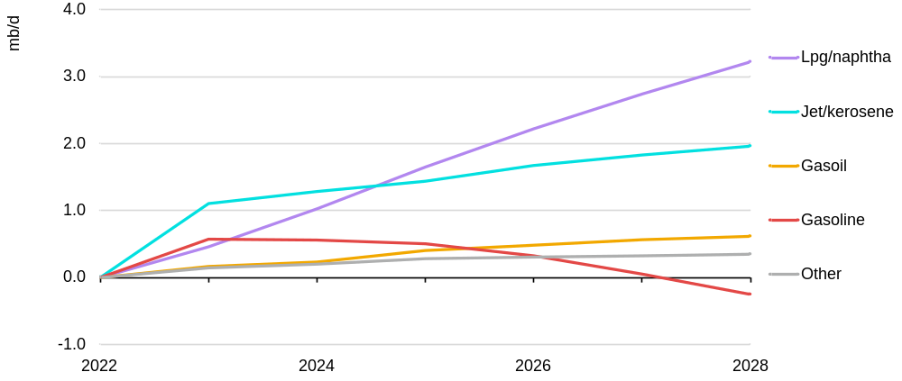
Petrochemicals and aviation underpin overall growth
石油化工和航空业支撑着整体增长
Cumulative growth 2023-28 by product 2023-28年按产品分类的累积增长
石脑油
煤油
气体油
汽油
其他
Petrochemical feedstocks (+3.2 mb/d) and rebounding jet/kero (2 mb/d) will dominate overall 2022-28 growth of 5.9 mb/d. Global gasoline demand will fall from 2024 while gasoil will rise by 600 kb/d.
石化原料（+3.2百万桶/日）和回升的喷气机/燃油（2百万桶/日）将主导2022-28年5.9百万桶/日的总体增长。从2024年起，全球汽油需求将下降，而汽油将增加600千桶/日。
Notes:
LPG/ethane and naphtha provide the largest share of growth in our forecast. Combined, they will rise by 3.2 mb/d between 2022 and 2028, more than half the total increase of 5.9 mb/d. Much of this will be concentrated in China, where many new plants have been built to process these feedstocks into petrochemicals.
Jet/kerosene will largely complete its rebound from the Covid-19 pandemic during 2023, especially as Chinese passengers return to the skies. Therefore, its overall growth of almost 2 mb/d will be heavily concentrated in the first year of the forecast, when it will rise by 1.1 mb/d.
Major road fuels will see much less growth, as a result of efficiency gains and EV sales. Gasoline use will be especially constrained, falling from 2024 onwards, with most of EVs’ impact coming for the fuel. Gasoil will grow by a modest 600 kb/d, supported by steady increases in lower-income economies.

Slide 4
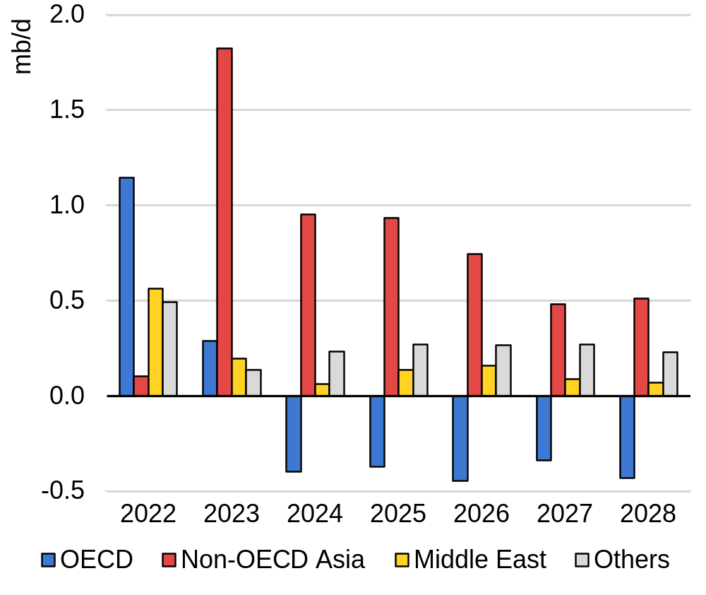
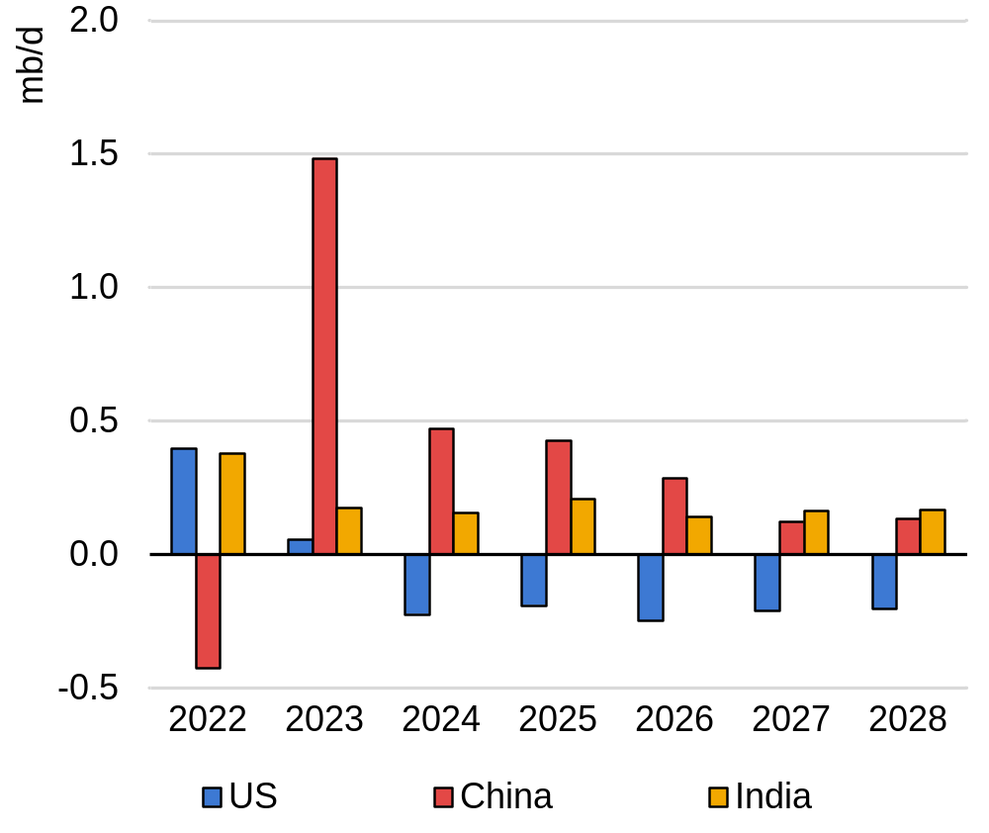
Asia dominates demand outlook, India to outpace Chinese growth
亚洲主导需求前景，印度的增长速度将超过中国
Demand growth various regions 各地区的需求增长
Demand growth, three largest oil consumers 三个最大的石油消费国的需求增长
经合组织国家 亚洲非经合组织国家 中东地区 其他
Non-OECD Asia leads 2022-28 demand growth, while the OECD declines from 2024. China posts strong gains at the start of the forecast, but India overtakes from 2027.
亚洲的非经合组织国家引领2022-28年的需求增长，而经合组织国家从2024年开始出现下滑。中国在预测之初取得了强劲的增长，但印度将从2027年起超过中国。
Notes:
Now, looking at where the demand is coming from, it should be no surprise that Asia accounts for the majority of the increase in oil use from now to 2028.
Non-OECD Asia will account for 5.4 mb/d of growth with China the largest contributor (+2 .9 mb/d).
A massive build-out of petrochemical capacity and its rebound from lockdown-hit 2022 will see China headlining global demand gains until 2026. Very high EV sales and slower petrochemical additions will see the pace of increase slacken in the final years of the forecast.
Indian demand is set to grow steadily, with a more limited energy transition impact incapable of outweighing a buoyant economic outlook. This will see demand growth in India outpacing China, to be the fastest growing oil consumer in the world, by 2027.
By contrast, overall OECD demand will decline by 1.7 mb/d 2022-28. This is the result of a combination of lacklustre GDP growth and strong energy transition policies in key oil consuming sectors.

Slide 5
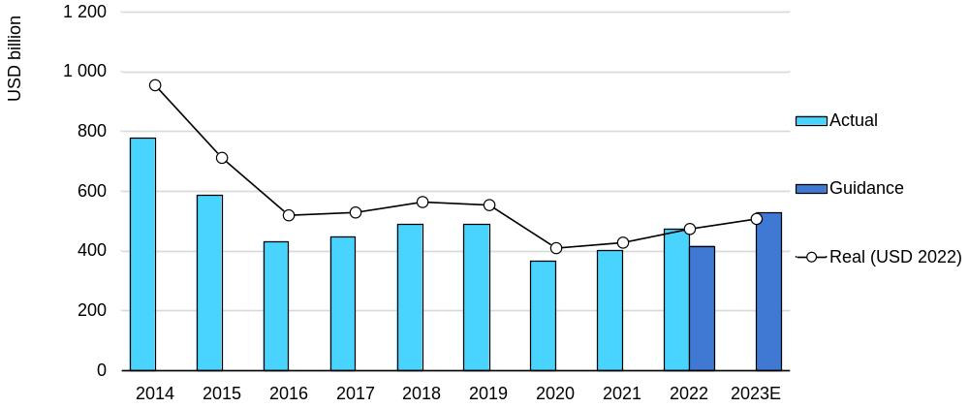
Upstream investments are recovering from pandemic-lows
上游投资正从疫情的低谷中恢复过来
Global oil and gas upstream capital spending 全球石油和天然气上游资本支出
实际值
指导值
真实值
(美元 2022)
While the impact of higher spending will be partly offset by cost inflation, if sustained, it should ensure markets are adequately supplied through the forecast period.
尽管较高投资额的影响将部分被成本通胀抵消，但如果这一水平的投资持续保持，可确保满足报告预测期间的预测需求。
Notes:
Turning over to investments, global upstream oil and gas investment is on track to increase by an estimated 11% in 2023 to USD 528 billion, compared with USD 474 billion in 2022, with both years coming in higher than the guidance outlined by companies in their original plans.
While the impact of higher spending will be partly offset by cost inflation, if sustained, it should ensure markets are adequately supplied, based on current demand trends.

Slide 6
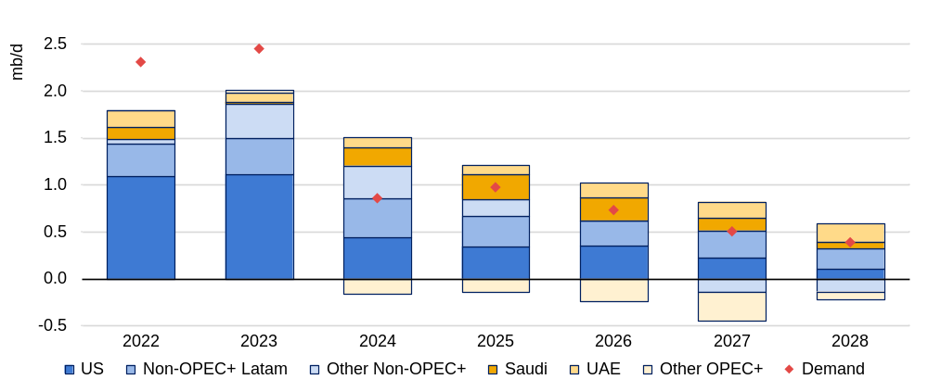
US-led capacity building slows but keeps up with demand
美国主导的能力建设放缓，但跟上了需求
Capacity growth by key regions and demand growth forecast (y-o-y change) 主要地区的产能增长和需求增长预测（同比变化）
美国 非OPEC+拉美地区 其他非OPEC+国家 沙特 阿联酋 其他OPEC+国家 需求
US, non-OPEC+ Americas dominate expansion of 5.9 mb/d vs similar demand growth. Saudi, UAE fuel OPEC+ increase. Capacity growth slows from 1.9 mb/d in 2022 to 300 kb/d in 2028.
美国，非欧佩克+美洲主导了5.9百万桶/日的扩张，而需求增长相似。沙特、阿联酋为OPEC+的增长提供了动力。产能增长从2022年的1.9百万桶/日放缓到2028年的300千桶/日。
Notes:
An expansion in global oil production capacity, dominated by the United States and other producers in the Americas, is set to moderate progressively over the medium term.
But the gains still keep up with the slower pace of projected demand growth over the 2023-28 forecast period.
The world’s total supply capacity is forecast to post a net increase of 5.9 mb/d to 111 mb/d by 2028, but a marked slowdown in US additions sees overall global capacity growth easing annually from an average 1.9 mb/d in 2022-23 to just 300 kb/d by the end of the forecast.

Slide 7
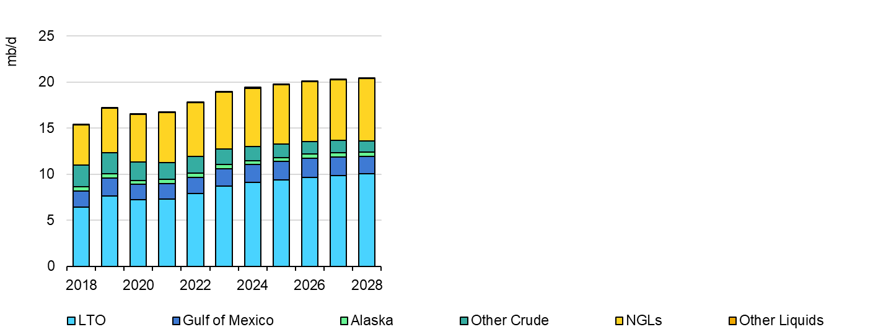
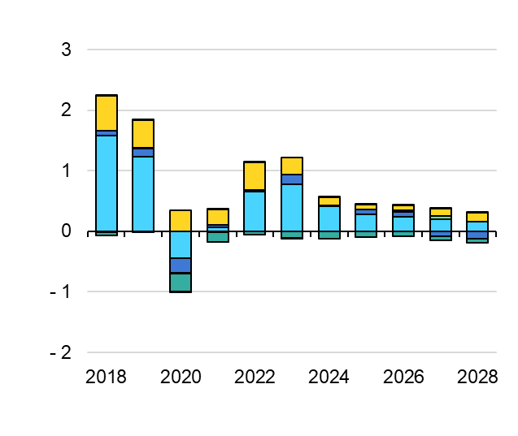
US growth moderated by shifting investment strategies
美国增长因投资策略的转变而有所缓和
US total oil supply 美国的石油供应总量
US total oil supply growth (y-o-y) 美国石油供应总量增长（同比）
页岩油 墨西哥湾 阿拉斯加 其他原油 天然气液 其他液体
Annual growth falls from 1.1 mb/d in 2022 to 110 kb/d in 2028. Shale, powered by the Permian, provides 80% of the gains. Total supply tops 20 mb/d starting in 2026.
年增长率从2022年的1.1百万桶/日下降到2028年的110千桶/日。页岩油提供了80%的收益。从2026年开始，总供应量将达到20百万桶/天。
Notes:
Despite climate action, concerns of underinvestment and a sharp slowdown in LTO, the United States remains the largest contributor to medium-term supply growth at 2.6 mb/d by 2028, of which 1.7 mb/d is crude oil. NGL production is forecast to rise by 860 kb/d to 6.7 mb/d, led by higher ethane exports, as US LTO continues to grow and natural gas production shifts to more liquids-rich plays.
The post Covid-19 recovery in US oil production was solidified in 2022 with production up 1.1 mb/d y-o-y. Total oil supply is expected to increase by a further 1.1 mb/d on average in 2023 to reach an all-time high of 19 mb/d.
However, the pace of expansion slows markedly from 2024 onwards as producers navigate the energy transition and US LTO companies struggle with higher costs, increasing decline rates and lower output from new wells drilled.
US crude oil production grows to 13.6 mb/d in 2028, setting new record highs through 2027. The increase is led by LTO, primarily from the Permian Basin.
The shale patch has matured financially to a lower growth trajectory as it focuses on disciplined investing, de‑leveraging and returning cash to shareholders. Reinvestment rates of 40‑60% are expected over the medium term, compared with more than 160% from 2015-17.
Publicly listed companies will likely continue to prioritise shareholder returns, look to increase efficiencies through acquisitions and limit organic production growth.
US LTO production grows 2.1 mb/d from 2022 to 2028, to 10 mb/d, with the Permian Basin providing 80%. Gains are front-loaded as 780 kb/d of additions this year slow to just 170 kb/d in 2028.

Slide 8
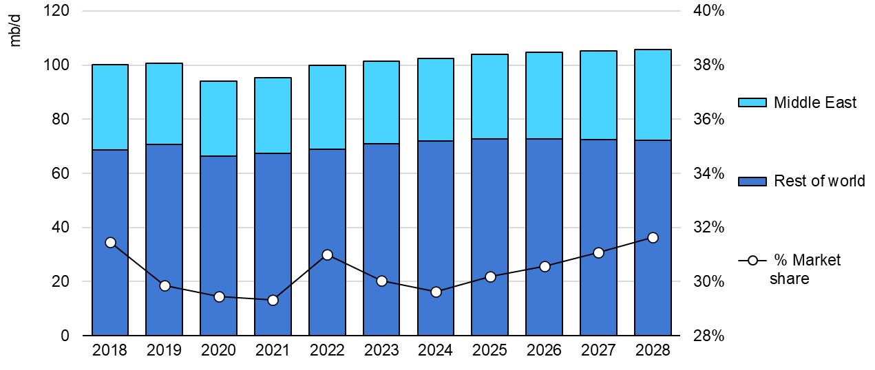
Middle East adds more barrels as US gains slow
中东地区增加了更多的油桶，因为美国的收益减缓了
Share of world oil market production 占世界石油市场产量的比重 (2018-2028)
中东
其他
市场份额
The region’s market share, led by Saudi Arabia and the UAE, rises to 32% in 2028 from 30% in 2023. Investment and market trends suggest the region’s share of world oil supply will rise over the longer term.
中东地区的市场份额在沙特阿拉伯和阿联酋的带领下，从2023年的30%上升到2028年的32%。投资和市场趋势表明，中东地区在世界石油供应中的份额将在长期内上升。
Notes:
The slowdown in US growth will enable producers from the Middle East – led by Saudi Arabia and the UAE – to add barrels to meet demand growth.
As a result, market share from the region rises to 32% in 2028 from 30% in 2023. Given current investment and market trends, the Middle East’s share of world oil production looks set to increase over the longer term.

Slide 9
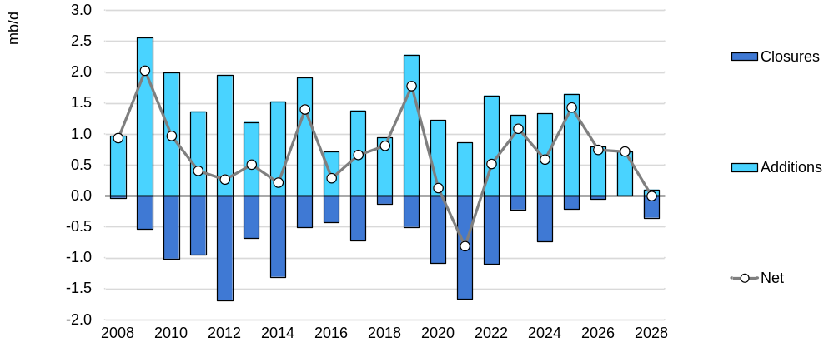
Refinery capacity returns to growth following wave of closures
炼油厂产能在关闭潮后恢复增长
Global refinery capacity changes, 全球炼油厂产能变化 2008-2028
关闭数量
补充数量
净值
Global refinery capacity set to expand by 4.4 mb/d over six-year period, with 6 mb/d of new builds partly offset by planned closures. East of Suez dominates expansions.
全球炼油厂的产能将在六年内增加4.4百万桶/日，其中6百万桶/日的新建产能将被计划中的关闭产能部分抵消。苏伊士以东地区的扩张占主导地位。
Notes:
More than 6 mb/d of new crude distillation capacity is scheduled to be completed over the forecast period.
At the same time, 1.6 mb/d of capacity is slated to shut, leaving a 4.4 mb/d net increase.
This extends the long-term trend of closure of capacity in high cost areas, e.g. Europe.
Globally, approximately 3.9 mb/d of crude distillation capacity was closed in 2020‑22, more than double the prevailing five-year average rate and well ahead of historical trends.
However, shutdowns following the Covid demand shock in 2020‑21 are now largely complete and gross additions outpace closures by a healthy margin for the next three years.

Slide 10
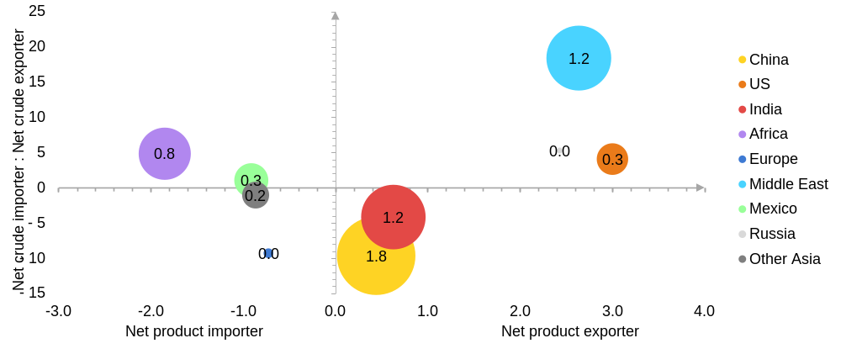
Product exporters dominate refinery capacity build-out
产品出口商主导了炼油厂的产能建设
Net refinery capacity changes, mb/d, 2022-2028 炼油厂净产能变化 （百万桶/日，2022-2028年）
中国
美国
印度
非洲
欧洲
中东
墨西哥
俄罗斯
亚洲其他国家
净进口国 净出口国
The heavy reliance on China’s spare refining capacity will be crucial in balancing product markets.
Beijing’s policy on domestic refining and the industry’s petrochemical integration will be key.
全球对中国剩余炼油能力的依赖将是平衡产品市场的重要因素。中国对国内炼油的政策和该行业的石化整合将是关键。
Notes:
New refinery capacity is predominantly located East of Suez.
The Atlantic Basin will see a brief increase early in our forecast, but thereafter China, India dominate
In a sign of the concentration of refining capacity, product exporting countries East of Suez account for the vast majority of the increase.
China leads the pack with 1.8 mb/d of gross refinery additions, with India and countries in the Middle East collectively joint second.
The latter region, in conjunction with new refineries in Mexico and Nigeria, will absorb an ever-greater share of their regional crude exports, thereby diminishing potential crude trade.

Slide 11
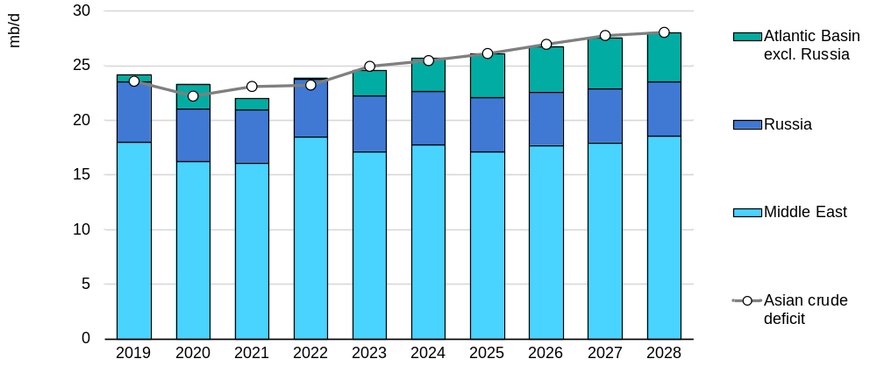
Atlantic Basin plays critical role in meeting Asian crude oil demand
大西洋盆地在满足亚洲原油需求方面发挥着关键作用
World crude and condensate balances (2019-2028) 2019-2028 年世界原油和凝析油结余情况
大西洋盆地(除俄罗斯外)
俄罗斯
中东地区
亚洲原油缺口
Falling refinery runs and strong supply growth from US, Brazil and Guyana boost Atlantic Basin exports by 4.1 mb/d. These west-east flows comes on top of Russian volumes diverted from EU, G7 countries.
炼油厂运行下降，美国、巴西和圭亚那的供应增长强劲，使大西洋盆地的出口量增加了4.1百万桶/日。这些由西向东的流动主要是俄罗斯从欧盟和G7国家转移的数量之上而来。
Notes:
As the driver of future oil demand growth, East of Suez will fundamentally shape global crude balances.
Baseload supply has extended from the existing Middle East flow to incorporate the near totality of Russian crude exports since 2022.
Yet still more volumes will be needed by China, India and other regional refiners in the coming years.
The Atlantic Basin producers will provide increasing swing supply volumes to meet month-to-month changes and annual growth in Asian refinery needs at the margin.
The Atlantic Basin, excluding Russia, will see its crude oil and condensate surplus increase by 4.1 mb/d as production rise in the United States, Brazil and Guyana and regional refinery activity falls in line with the contraction in demand for transport fuels.
Asia’s crude and condensate import requirements will rise by 5.1 mb/d to 28 mb/d in 2028.
Continued demand growth in Asia will by far outpace increased crude supplies from the Middle East over the forecast period.
The Atlantic Basin crude surplus will play a critical role in meeting Asian demand over the forecast period.

Slide 12
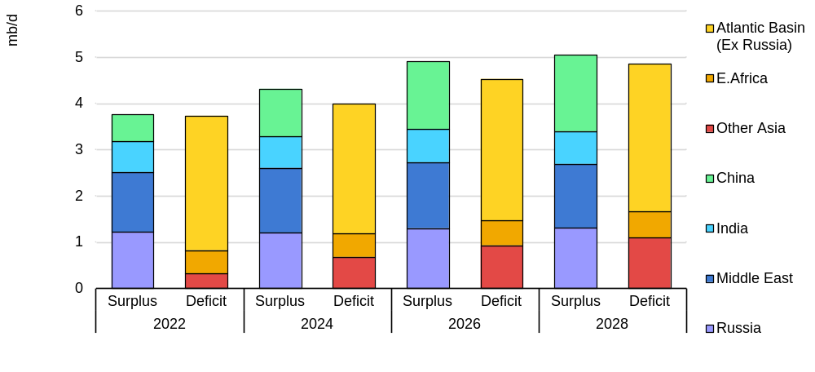
Growing Chinese exports needed to balance global gasoil demand
需要不断增长的中国出口来平衡全球天然气石油需求
Middle distillate balances by region, 各地区中间馏分油余额 2022-2028
大西洋盆地(除俄罗斯外)
东非
其他亚洲地区
中国
印度
中东
俄罗斯
盈余 赤字
Meeting growing gasoil deficits in the Atlantic Basin and other Asia will require steady increases in gasoil exports from China. Other regions will struggle to boost exports significantly.
要满足大西洋盆地和其他亚洲地区日益增长的气体油赤字，需要中国稳步增加气体油出口。其他地区很难大幅提高出口。
Notes:
Global middle distillate markets remain roughly balanced over the 2022-28 period.
Regions in overall deficit (Atlantic Basin excluding Russia, East Africa and Other Asia including OECD Asia Oceania) see their gap widen by 1.1 mb/d.
This is matched by sizable increases from net exporting regions, particularly China.
China now has the greatest share of installed capacity in the world, after overtaking the United States in 2022, and will remain the largest holder of spare refining capacity over the medium term. Crucially, our forecast for product balances is heavily dependent on higher Chinese product exports, especially for diesel.
China’s internal policies aimed at reducing emissions from its refining sector could lead to continued volatility in product export volumes however and yet again upend global supply flows and margins in the medium term.

